Slide 1
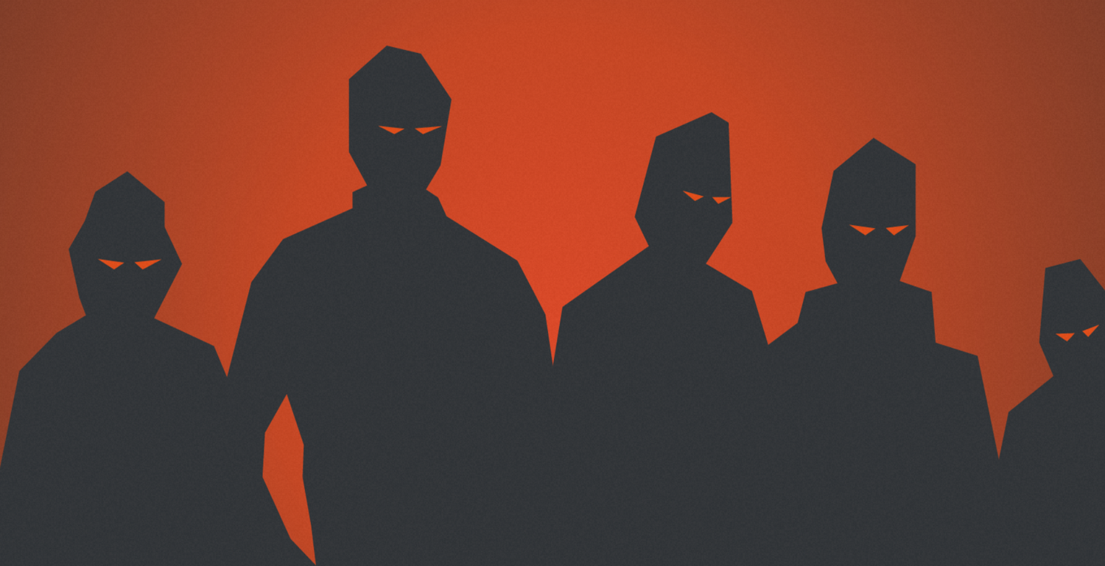
Common Threat Actor Strategies

Slide 2

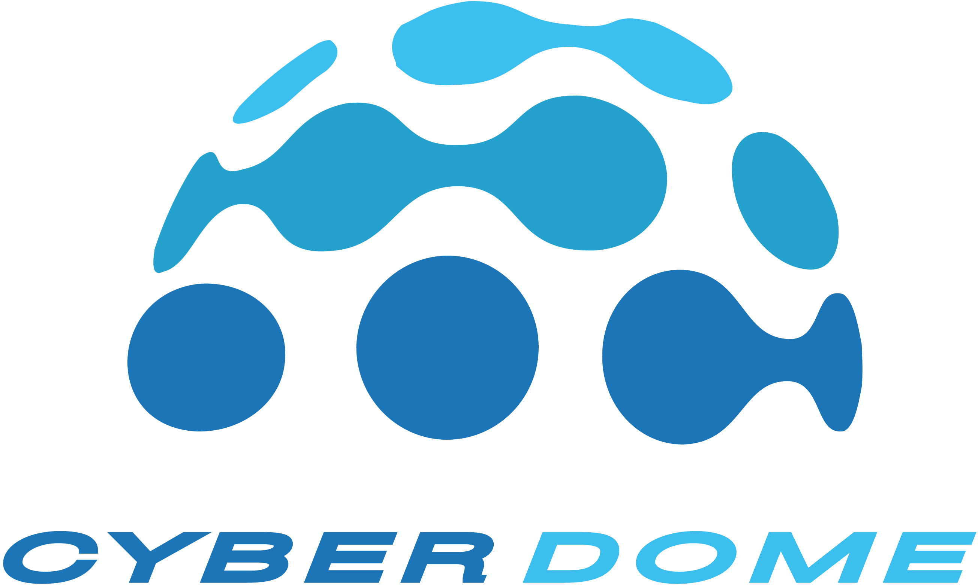
We see an average of more than ten ransomware attacks in our Threat Intelligence feeds
Attackers are now using highly automated attack chains
We see attackers move from access to a breach in under 20min
Industry-wide, there is increased maturity on ransomware and phishing as a service
The gloves are now off. Hospitals and Critical Infrastructure are on the menu now with most major threat actors
MFA stops a very large percentage of these, all of the things which CD has seen in our operation.
What We’re Seeing

Slide 3
Threat Actor Strategies and Preventions Eye Chart
Initial Access Techniques
VPN
Phishing
Known Creds / Brute Force
Default/Service Accounts
External Access Vulnerabilities (SonicWall / Fortinet especially)
Pwned Vendor
Helpdesk Impersonation
Weak Encryption on Domain
Misconfigured Cert Templates
Escalation Techniques
Credential Harvesting
Lateral Movement
Priv Escalation
Preparation
ESX Pivot
Exfil Data
Escalation Techniques
Encrypt VM Hosts
Lessor Extent: Encrypt workstations
Threat Actor
Strategies
Preventions
MFA (all the things)
MDI / Defender o365 (✨CD 2.0)
Patching (Prioritize KEV)
External Attack Surface (✨CD 2.0)
Vendor Remote Access Strategies (Not always on, limit access)
Tell your employees what you won’t ever ask from them.
Segment / Scope down VPN perms
Talk to NISC/Meridian
Verify who patches their servers
Assess if worthwhile or Cloud
Are EDR tools (Defender) installed?
Preventions
Distinct Accounts
No user + admin in the same account
Don’t reuse passwords
LAPS is worth the effort
Network Segmentation
Vlans are a great start
Segment your backup servers, OT, and go by criticality
Preventions
ESX Patching
NISC data encryption of PII tables (on request)
What's in your public/shared drive?
Preventions
Backups (with different creds and segmentation!)
IR Plan
  What do you do? (We have playbooks!)
  Who do you call? (Your G&T and CD are here to help)
  How do you restore?
Prevention
Layers

