Slide 1
KAMO HQ
Wireless Network Upgrade
A B H ISH E K K AWTIKWA R
SR N E TWO R K SEC U R ITY A RC H ITEC T, M STM , C C N P, C ISSP KA M O P OW E R

Slide 2
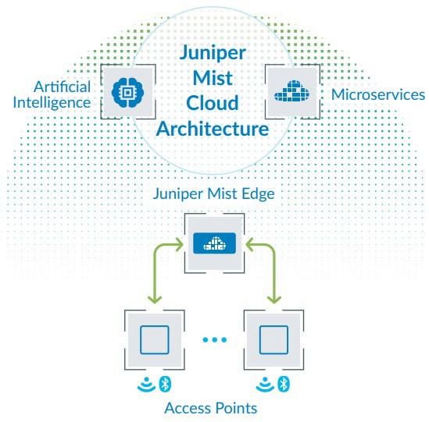
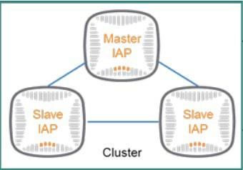
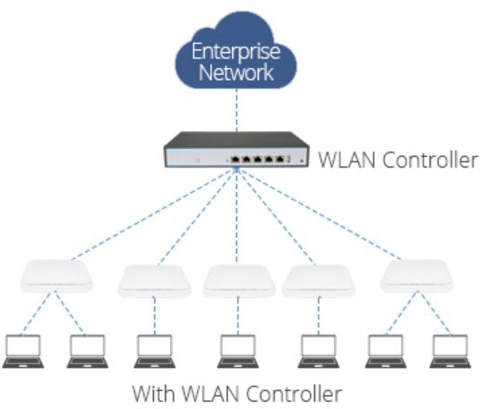
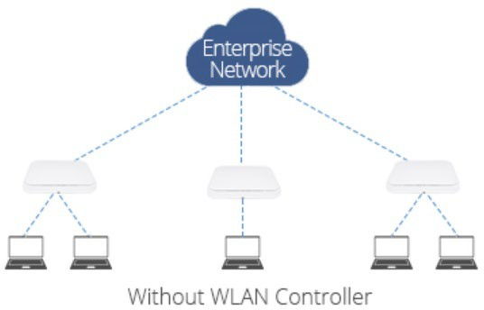
The Evolution of WLAN Networks
Individual Wireless APs
Virtual Controllers (Master and Slaves) / Centralized Hardware Controllers and Wireless APs
Cloud Portal and Wireless APs

Slide 3
Juniper Mist AP Overview
Juniper Mist APs operate in conjunction with the Juniper Mist AI cloud
Single pane of glass for managing all APs from anywhere
Indoor and outdoor deployments
Provision – Zero-touch provisioning for rapid deployment
Deploy – Template based consistent configuration
Operate – SLEs (Service Level Expectations), Alerts, Marvis Virtual Network Assistant, Marvis Actions
Supports Wi-Fi 6 technology for better wireless performance and Bluetooth Low Energy (BLE) for wayfinding

Slide 4
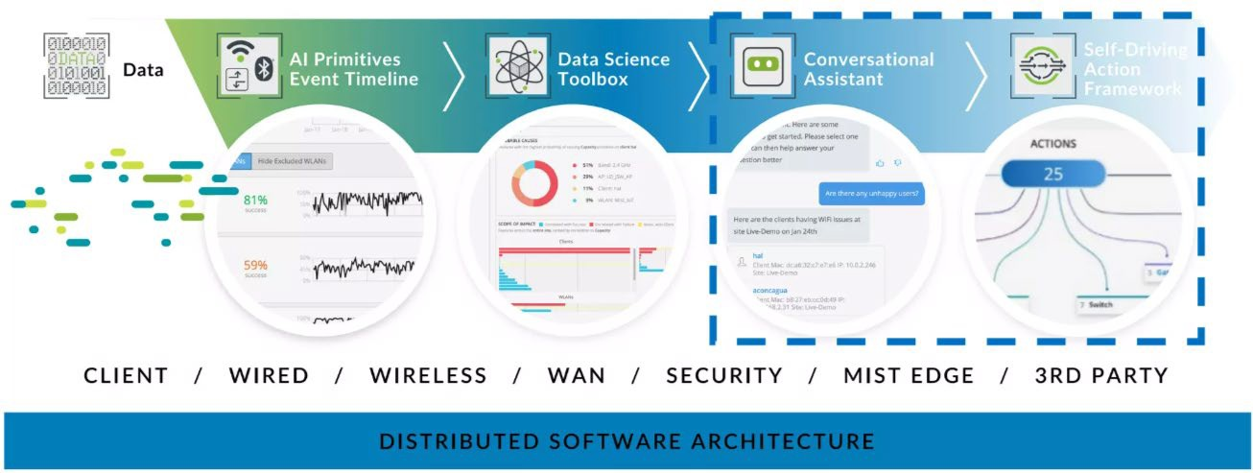
Juniper Mist AI Architecture

Slide 5
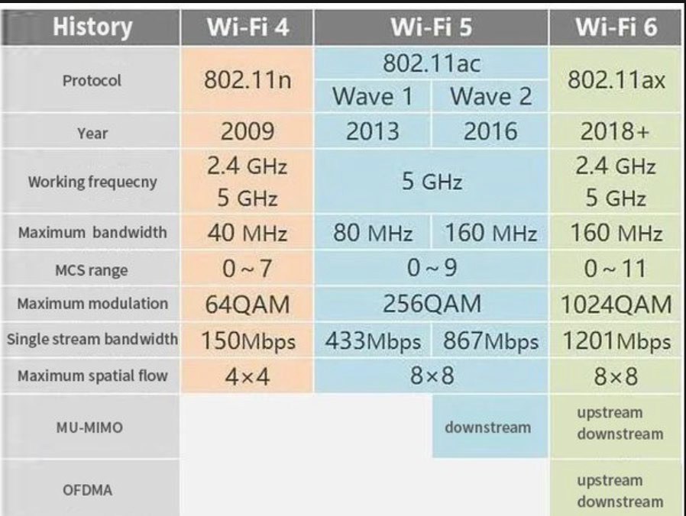
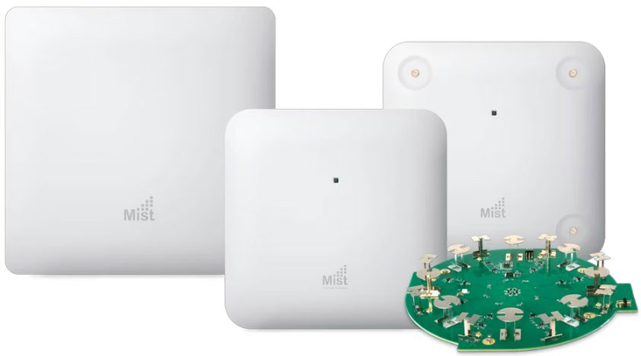

Wi-Fi Standards / Bluetooth Low Energy (BLE)

Slide 6
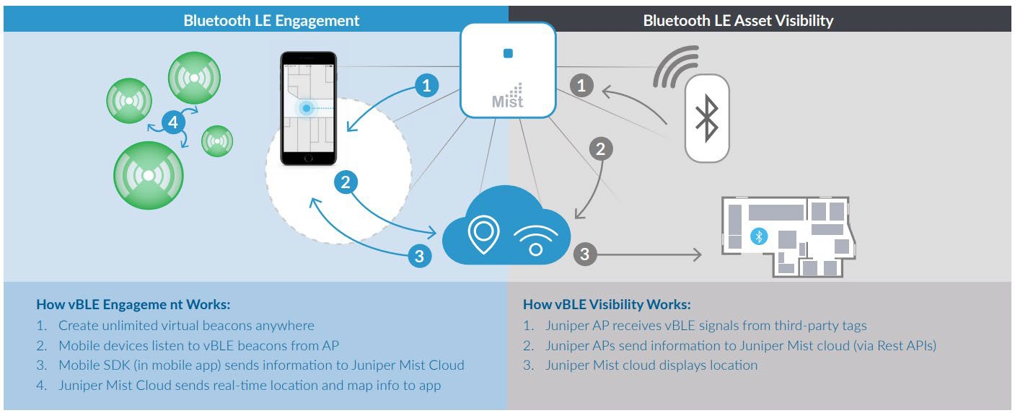
HOW JUNIPER Virtual BLE WORKS

Slide 7
Authentication and Onboarding
Juniper Mist IoT Assurance is a “MAC-less” and “NAC-less” onboarding service
Simplified onboarding with Multiple Pre-Shared Key (MPSK) identity in the new era of MAC randomization
Key life cycle management
Allows full segmentation and policy control as with traditional 802.1X authentication
Perfect solution for IoT and BYOD devices

Slide 8
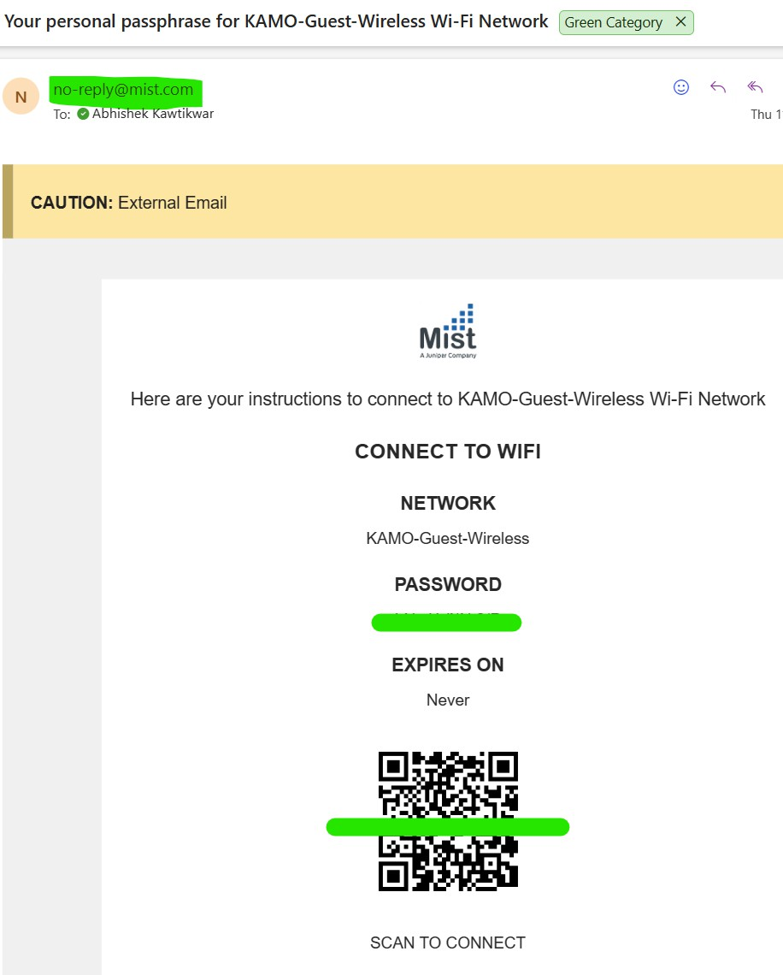
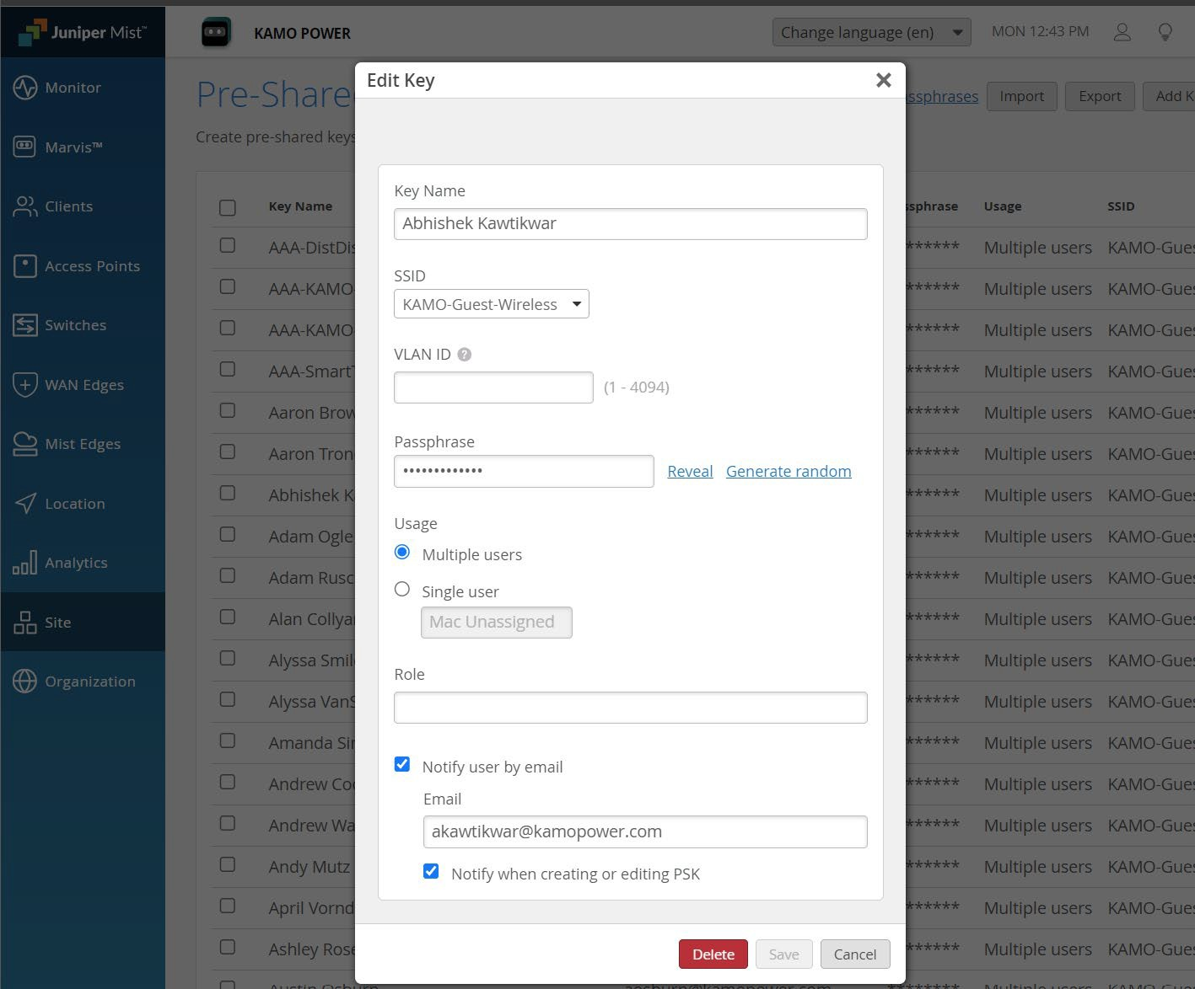

Slide 9
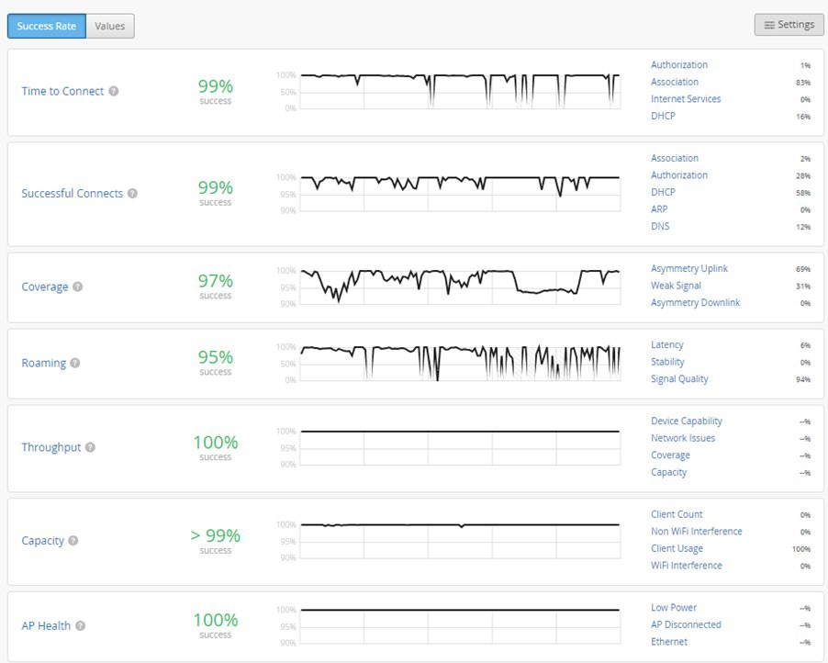
Mist Wi-Fi Assurance
Service Level Expectations - Time to Connect, Successful Connects, Coverage, Roaming, Throughput, Capacity, AP Health
Monitor network in real time and send alerts when service levels degrade
Dynamic Packet Captures
Mist AI can track user experience metrics, such as application performance and Wi-Fi signal strength, to identify and address issues that impact end-users

Slide 10
AI-Powered – Network Troubleshooting
Proactive Issue Detection - Mist AI constantly monitors your network for anomalies and potential problems. It can identify issues like slow Wi-Fi speeds, connectivity problems, or even potential security threats before they significantly impact users
AI-Powered Diagnostics - When issues arise, Mist AI can quickly pinpoint the root cause. Its AI algorithms analyze network data, user behavior, and device performance to identify the source of the problem, whether it's a faulty access point, a congested network link, or a client device issue
Automated Troubleshooting - In some cases, Mist AI can even automatically resolve issues without requiring manual intervention. For example, it might automatically adjust power levels on access points to improve coverage or re-associate clients to a less congested access point
Simplified Remediation - Even when manual intervention is required, Mist AI provides network engineers with valuable insights and guidance. It can suggest potential solutions, prioritize tasks, and even provide step-by-step instructions for resolving the issue

Slide 11
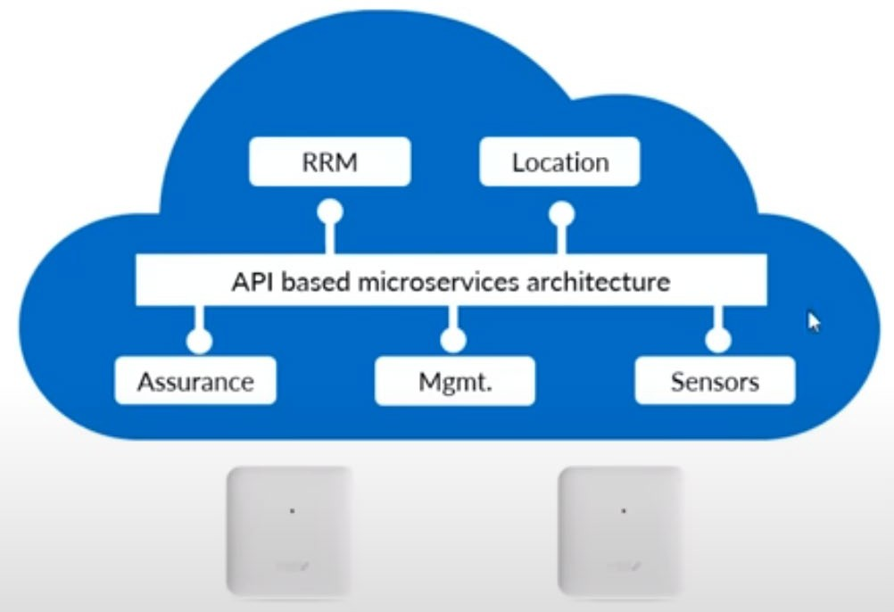
MIST AI + Microservices
Agility - New features and bug fixes can be deployed rapidly, often on a weekly basis
Scalability - Services can elastically scale up or down as needed, ensuring optimal performance
Flexibility - Enterprises can easily add or remove features to meet changing requirements
Provide full programmability via open APIs for automation and easy integration with third-party or inhouse applications

Slide 12
Upgrades and Backups
Upgrades
  Latest firmware and software versions
  Reduced downtime - Adjust power levels, associate clients to different APs
  Improved stability and security
Backups
  Automated backups
  Reduced manual effort
  Improved data security

Slide 13
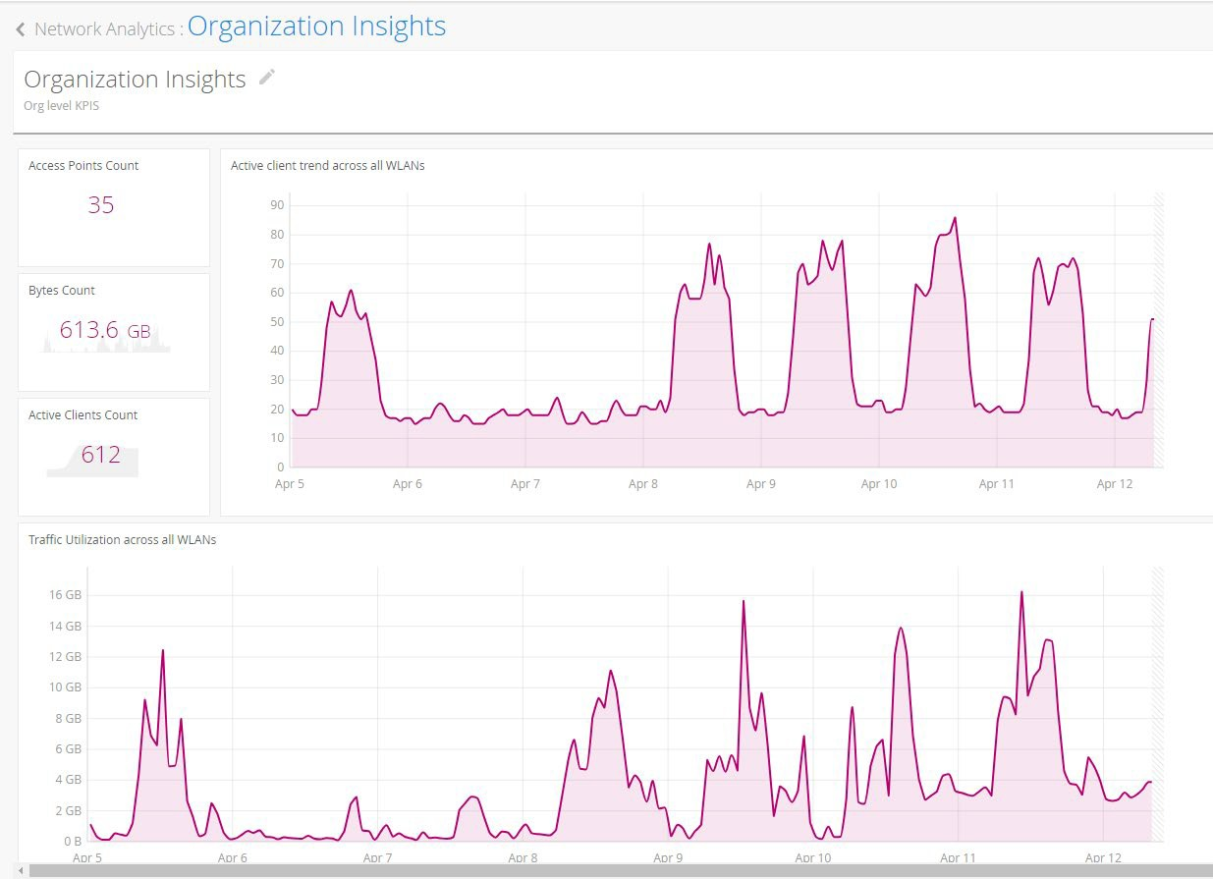
AI-Driven Insights
AI-Driven Insights - Mist uses AI and data science to analyze metadata from access points and switches, providing actionable insights
Network Analytics - Network performance, Traffic throughput, network trends
Occupancy Analytics - Identify overcrowded areas
Engagement Analytics - Dwell Time and Visits
Premium Analytics - Audit Logs and Inventory

Slide 14
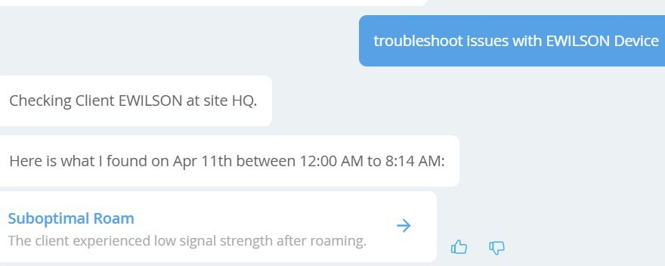
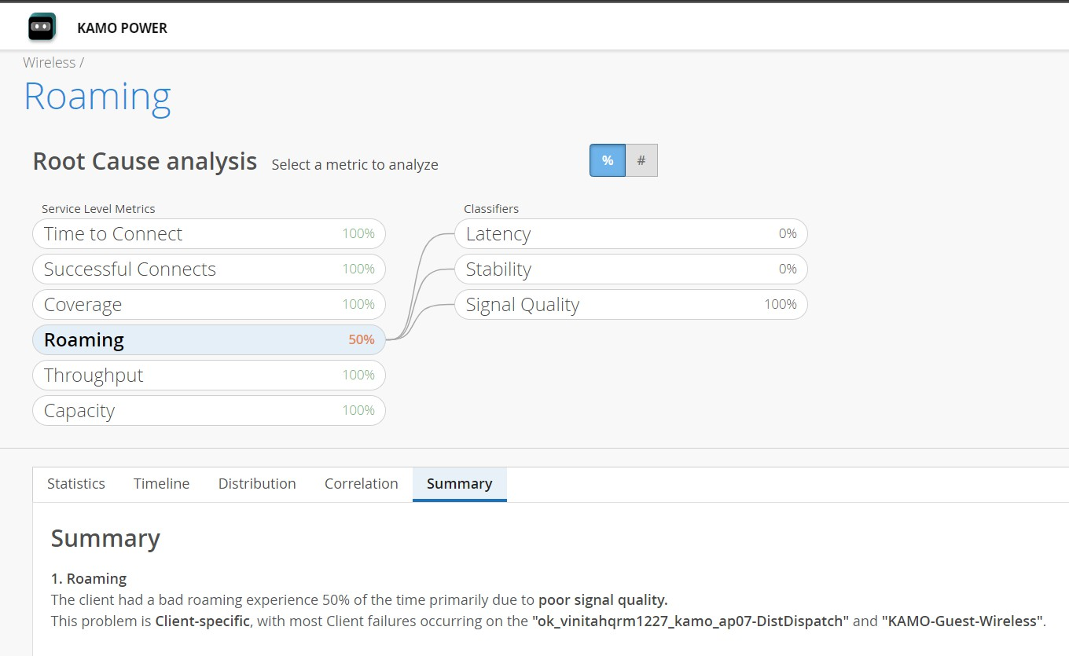
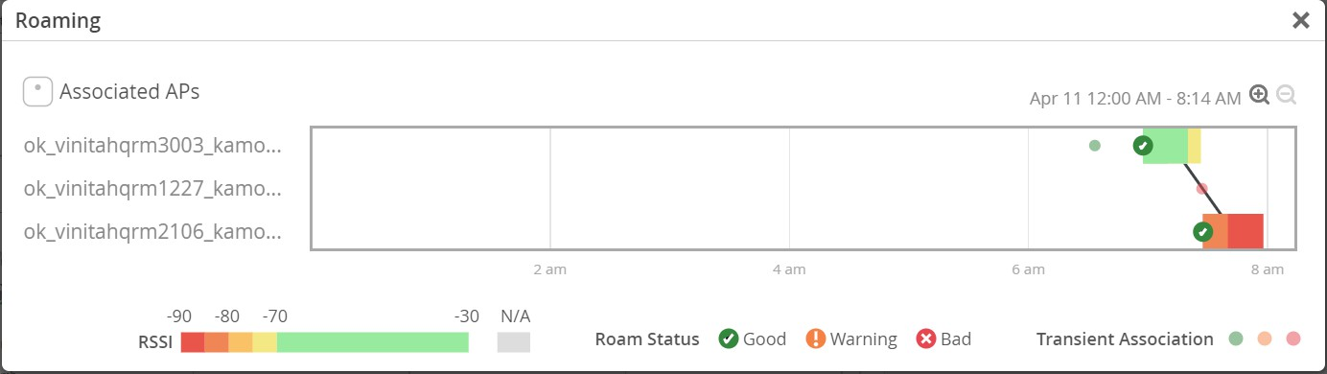
Marvis – Virtual Network Assistant

Slide 15
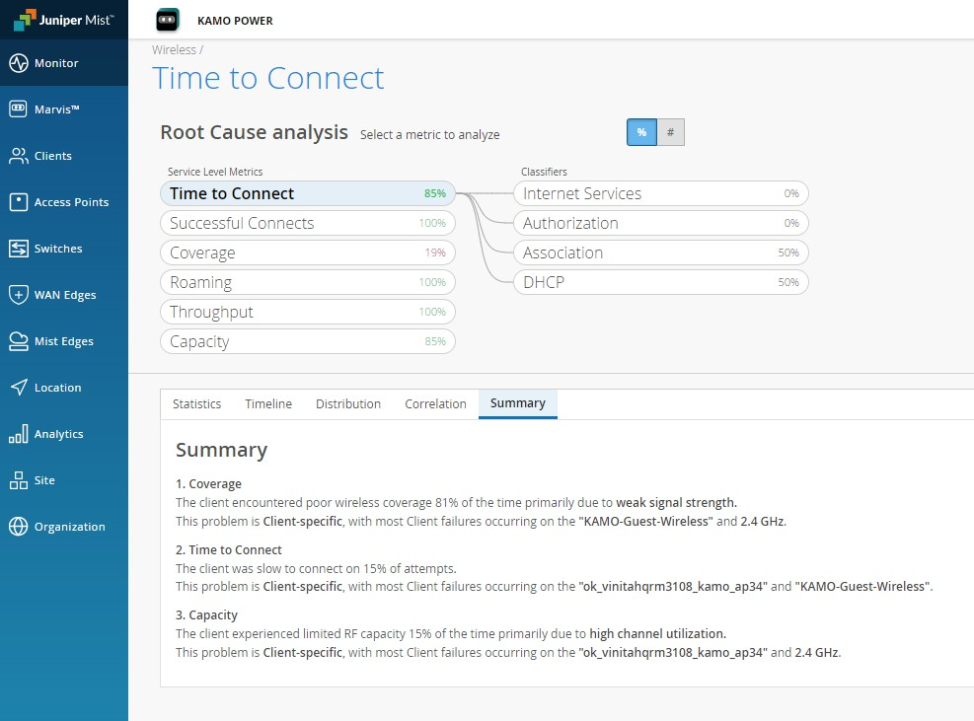
Root cause Analysis

Slide 16
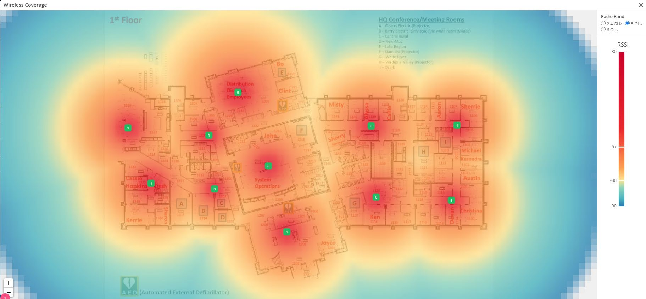
Wireless Coverage

Slide 17
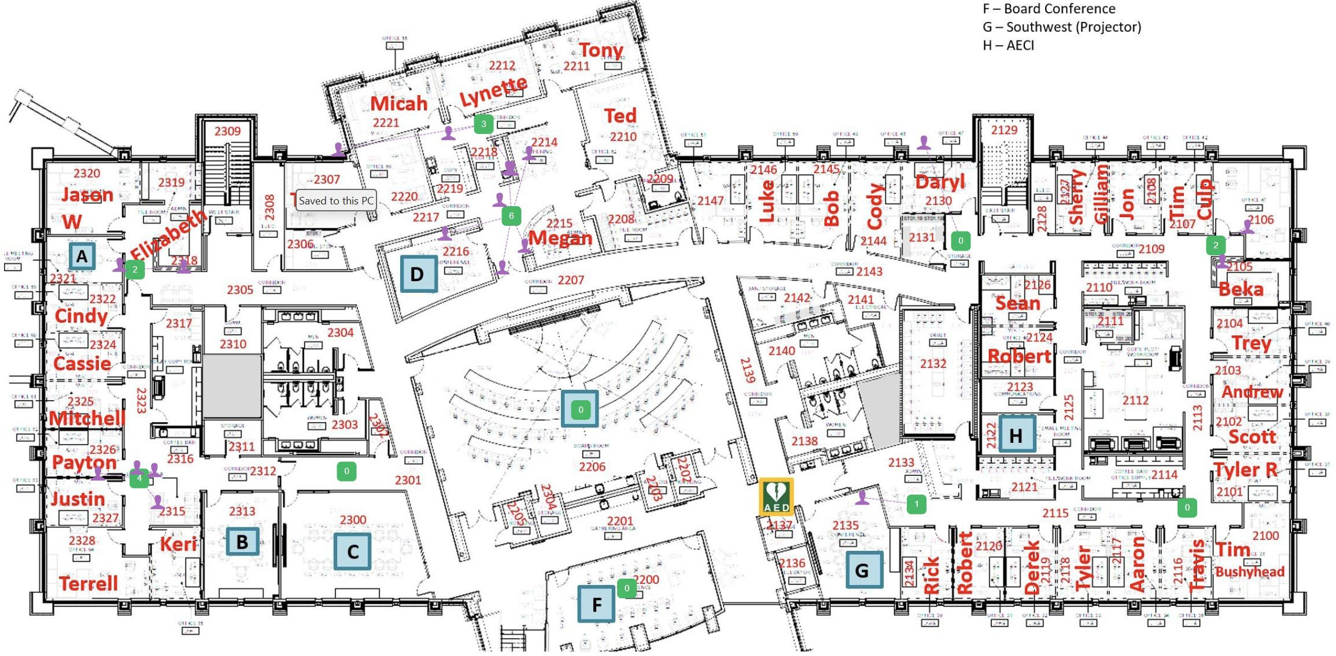
Location – Live View

Slide 18
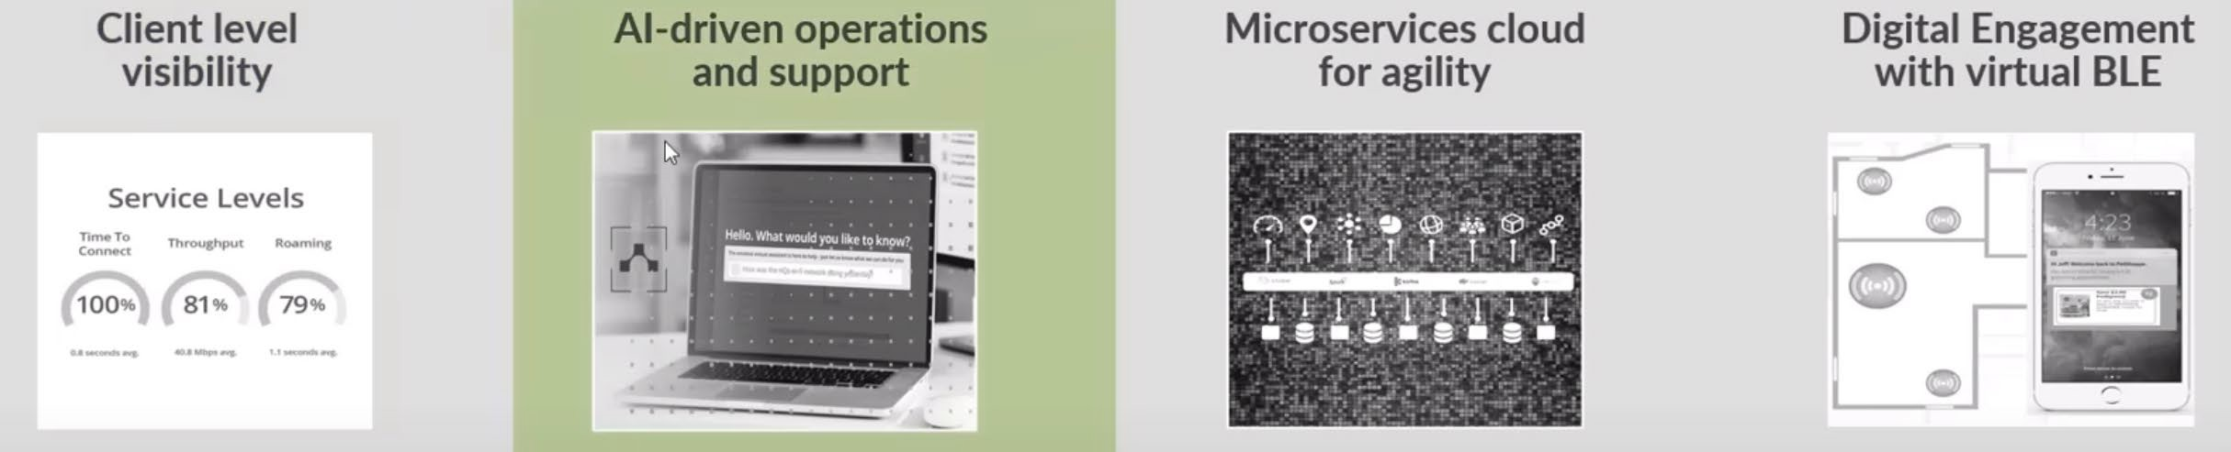
Summary
User Experience – Cloud resources to measure and improve end user experience
AI-Driven Operations and Support with Marvis
Microservices Cloud – A modern microservices architecture ensures a network that is easy to operate and agile
BLE Location Services – Engage with end-users utilizing Juniper’s built-in location services

Slide 19


