Slide 1
Getting value from ai
December 10, 2024
Use cases
As a search engine
Brainstorming Concepts
Documentation
Automation of Routine Tasks

Slide 2


search engine
Reduce time spent scrolling search results & docs looking for relevant info
“command line uninstall any apps with name vmware horizon client”
“give me the command to silently install DUO windows RDP logon agent”
Tasked with something new? Share the desired outcome to get started
“We need to protect our SSH switch access with MFA. Where should we start?”
“What does it take to get started with Microsoft AutoPilot?”
Have an error message or code?
“This script {text} fails with error {text}”
Want help creating an excel formula?

Slide 3
Brainstorming
Concept development, roleplaying, and inspiration
“can you give me a secure, but feasible, role-based active directory structure & strategy?”
“Let’s come up with a schema for how to name virtual machines”
“we are planning a 1-hour all employee meeting and would like to develop a plan for getting everyone involved in an idea storming session.
“Fun group names for employees who occasionally hang out at wineries.”
(Wine Down Crew, The Cork Dorks, Pour Decisions, Sip Happens, Sip & Socialize)

Slide 4
Documentation
Create documents, standard operating procedures, guidelines, and more.
“create documentation that explains how IT can maintain printer installs with the below script: {paste script text}”
“write a one-page document that outlines appropriate use of our critical/emergency text caster”
“write a policy that addresses ITIL's change management standards”
“write a charter for a culture committee that is made up of employees only”

Slide 5
Automation
Increase efficiency, reduce errors, and create bandwidth for strategic efforts
Example scripts we’ve used AI to generate:
Mass deploy BIOS & Driver updates to Dell PCs & Laptops
Backup & restore key user local AppData
Monitor idle PCs & auto-reboot
Daily task - lookup & disable all domain admins
Hands free printer installs & location-based defaults
Poor man’s VMware Horizon Client (Connect to PC)
New Server Deployment & Hardening Fully Scripted (5,000+ lines)

Slide 6
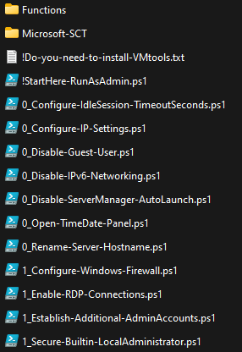
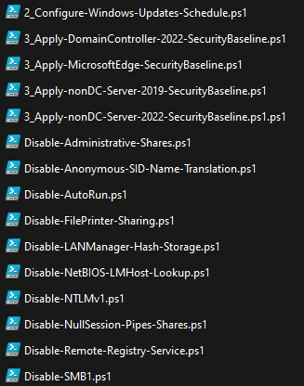
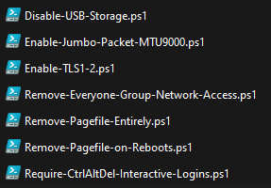
New server deployment

Slide 7
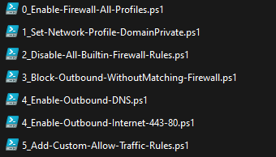
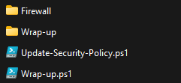
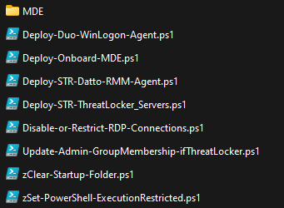
New server deployment

