Slide 1

Microsoft Defender for Identity

Slide 2




Slide 3
Why the Discussion About MDI?
MDI is now being leveraged as part of Cyber Dome 2.0!
Formerly known as Azure Advanced Threat Protection, it was rebranded in 2021 for product line consistency and to emphasize the focus on identity threat detection and response (ITDR).
MDI is complimentary to existing EDR tools. Proactively identifies threats before breaches occur by allowing insights to all domain controller traffic.
Deployment of MDI will greatly enhance overall security posture. It also contributes to Secure Score metrics within Defender for Office 365.

Slide 4
A Look at Some of the Features of MDI
MDI Sensor installation is required (only on domain controllers).
Constantly monitors all user activity and compares it to a behavior baseline.
Integrates with Sentinel, allowing for correlation between identity-related alerts and EDR alerts.
Real-time alerts for detected threats, containing visuals to help understand scope and impact.
Automated responses to threats, such as disabling compromised accounts, isolating systems, and resetting passwords.
Helps with ASR, via best practice recommendations in the exposure management dashboard – (i.e. misconfigured accounts or overly permissive access controls)
Provides insights to attack paths, chains of exploitable relationships leading to a high value target.

Slide 5
Which Types of Suspicious Activities Can Be Detected?
Brute force attacks on user accounts.
Potential "Kerberoasting" attacks – attackers requesting SPN service tickets for offline cracking.
Golden Ticket attacks – Forged Kerberos TGT (via the krbtgt account hash) for virtually unrestricted domain access.​
Lateral Movement – Attempts to move across systems to gain access to sensitive resources.​
Privilege escalation and/or attempts to modify critical security groups.​
Abnormal behavior, such as users accessing unusual resources.
LDAP enumeration: Detection of attempts to query the AD database for users, groups, or devices.

Slide 6
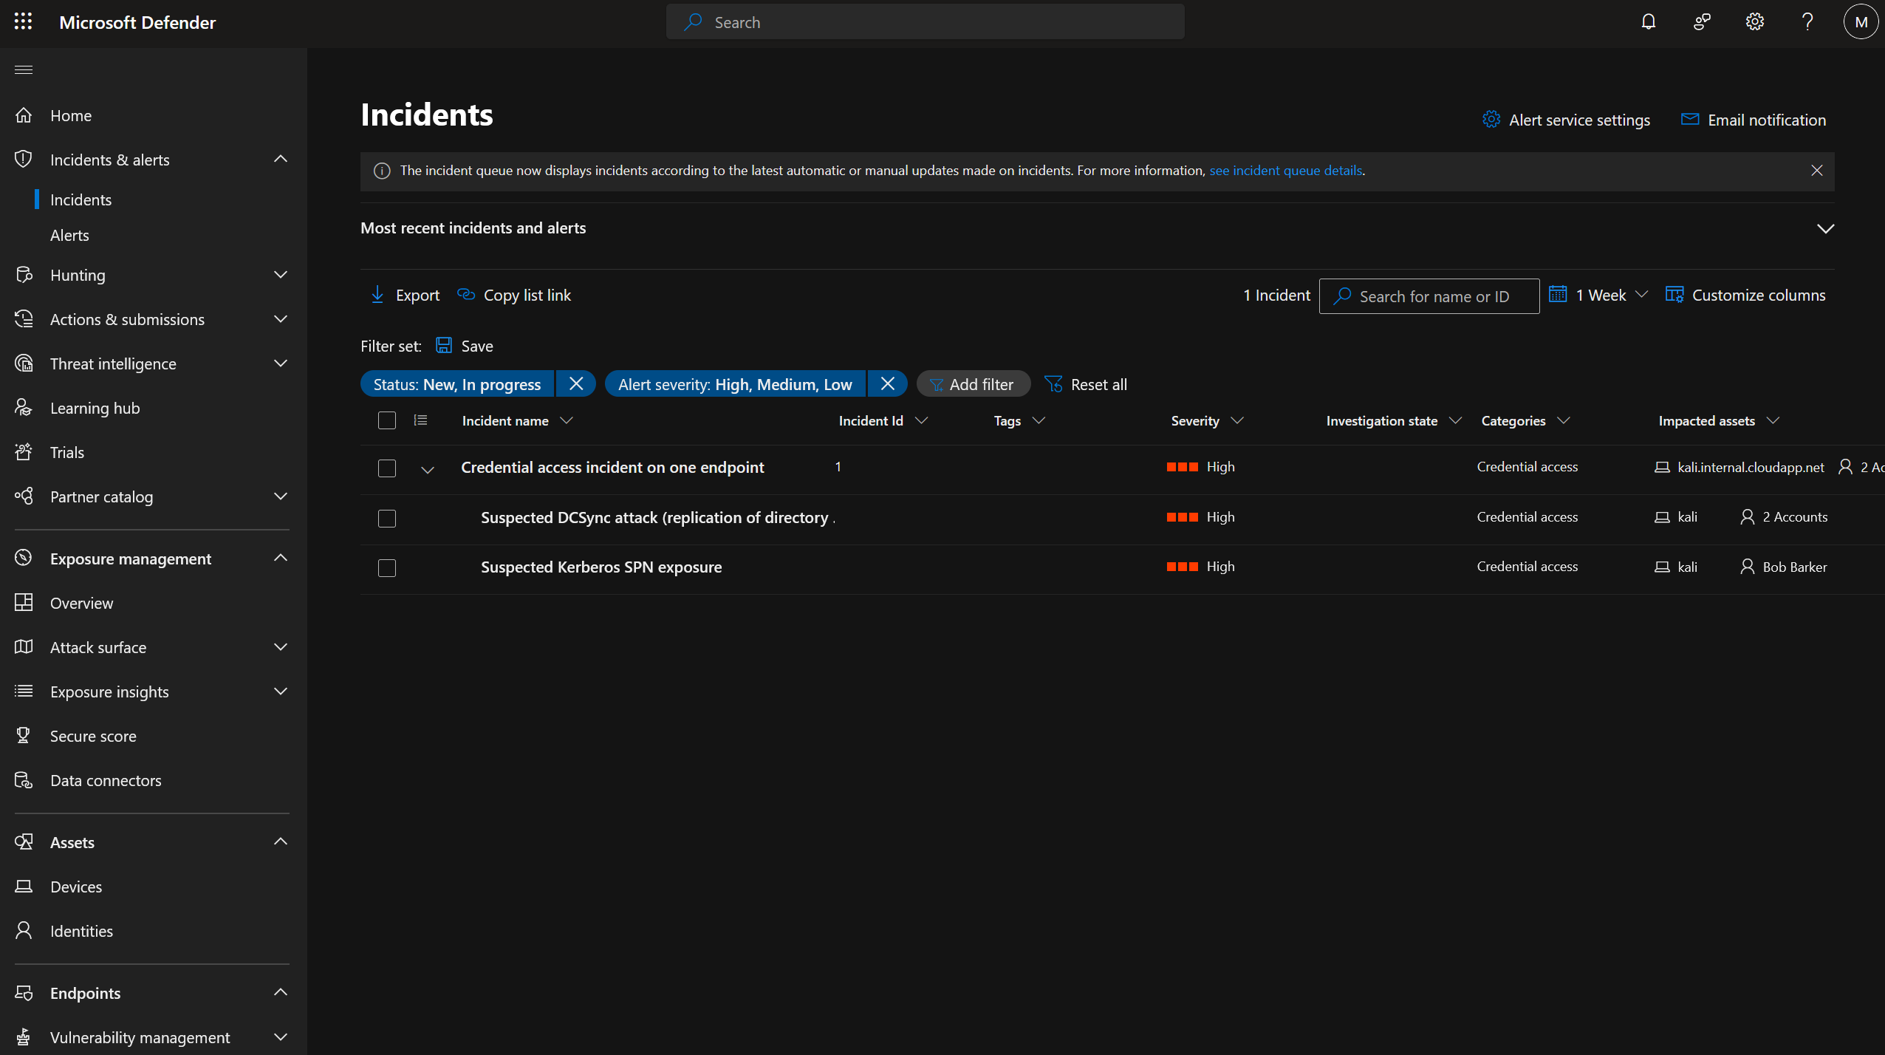

Slide 7
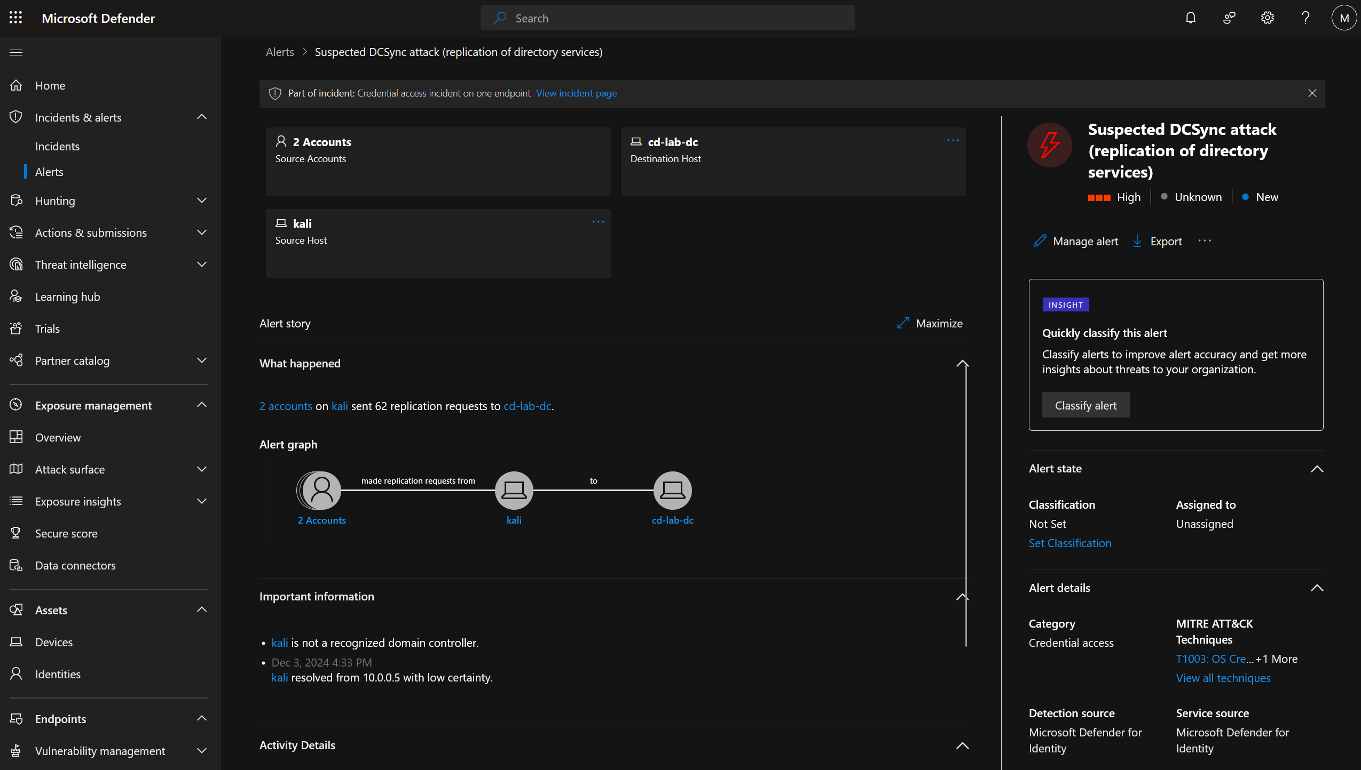

Slide 8
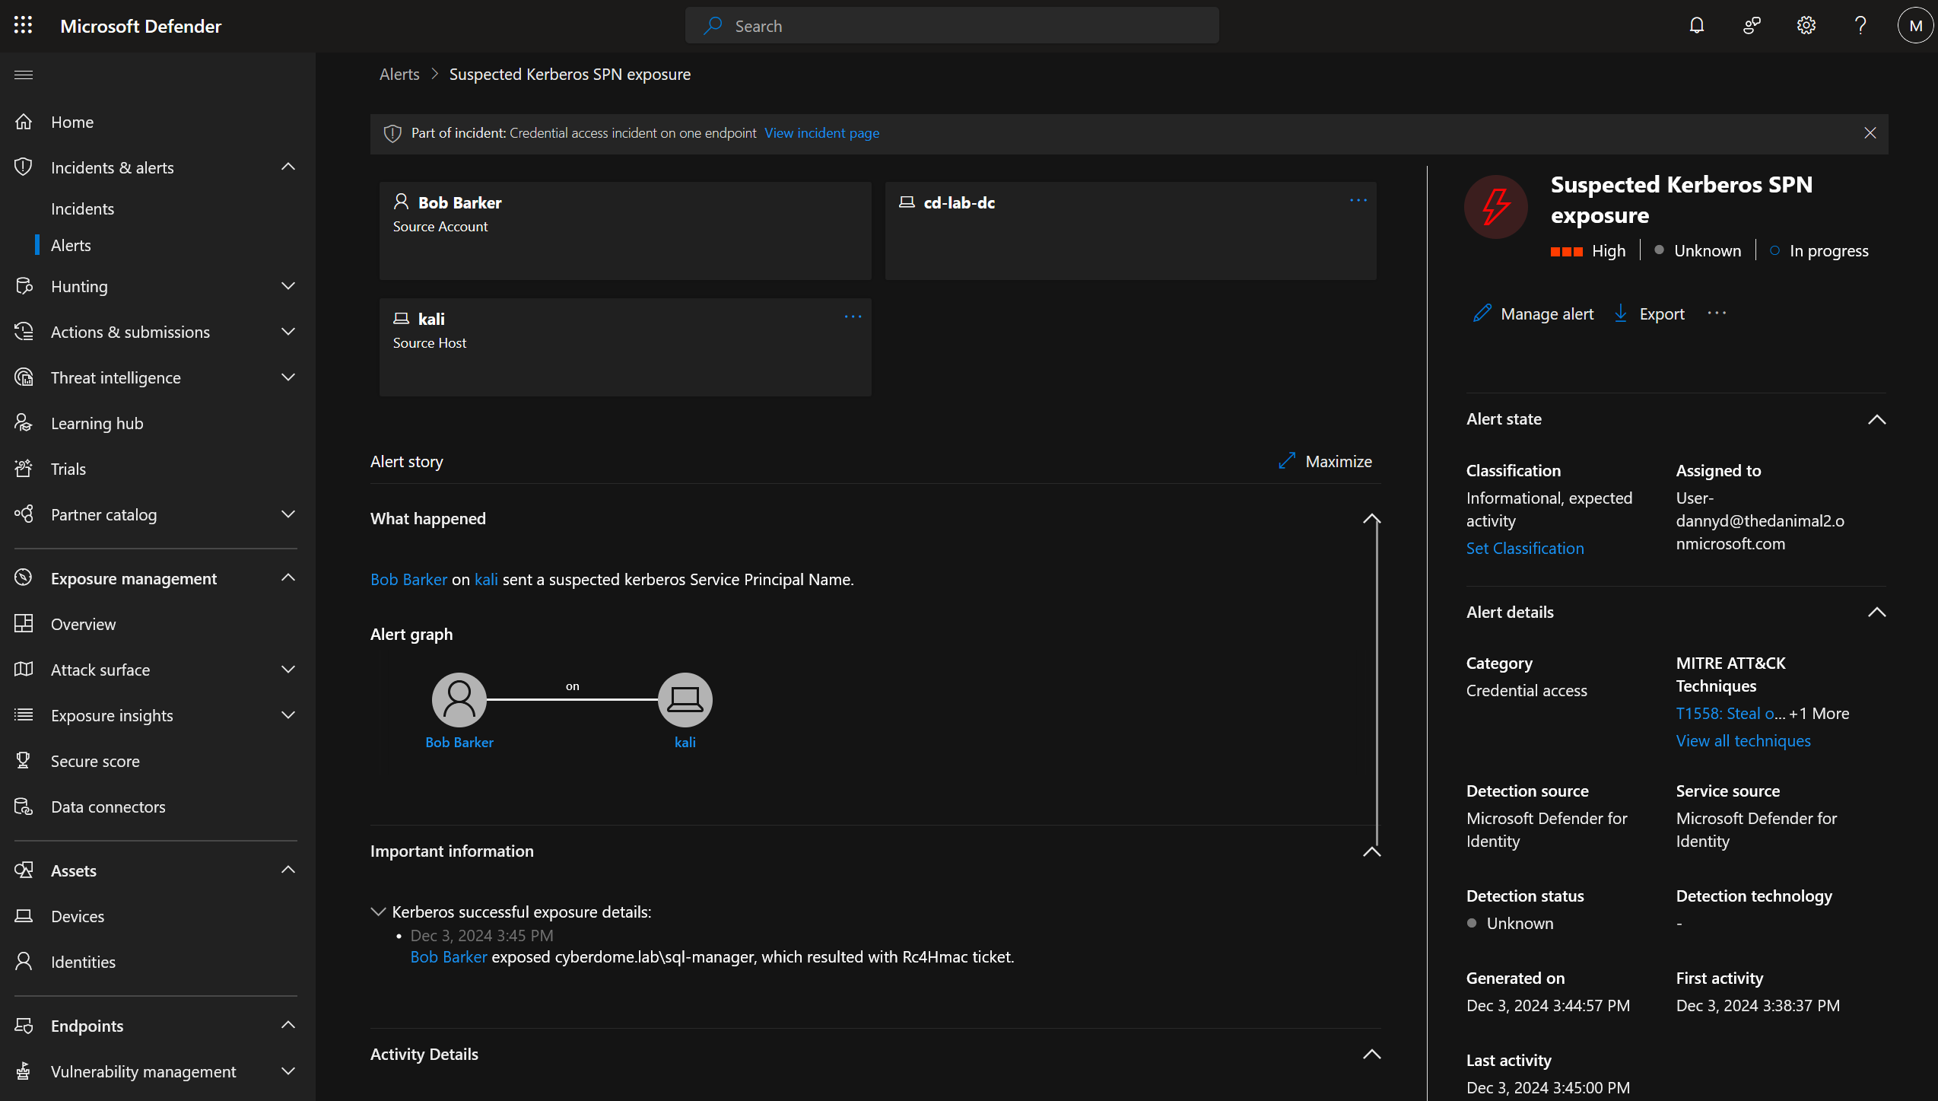

Slide 9
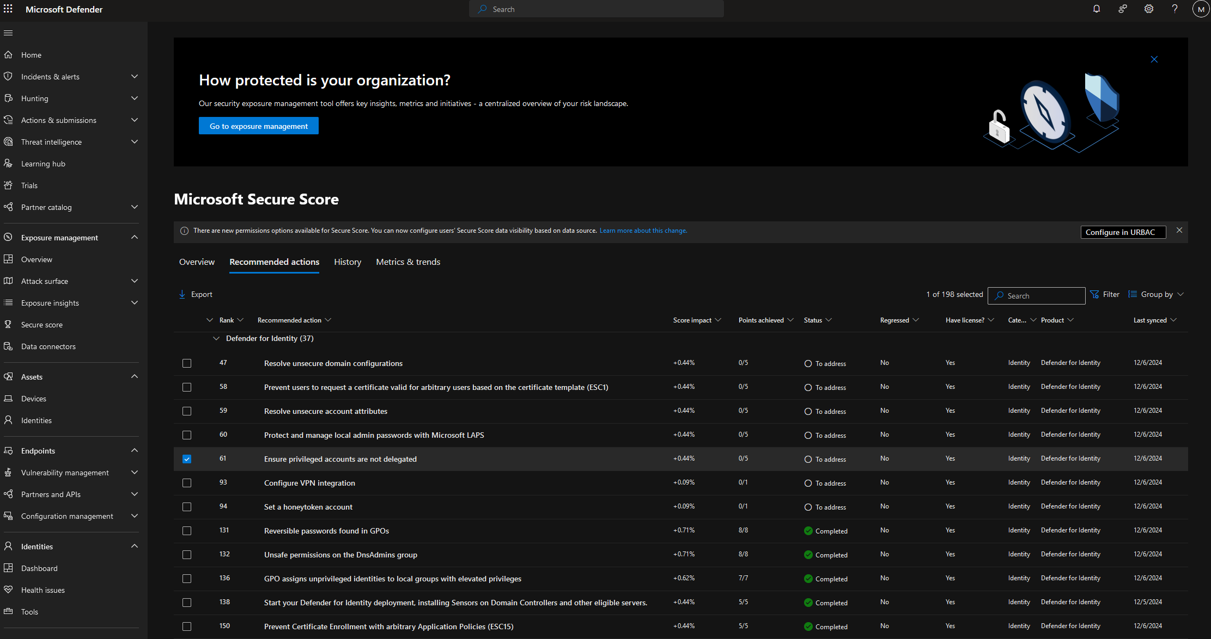

Slide 10
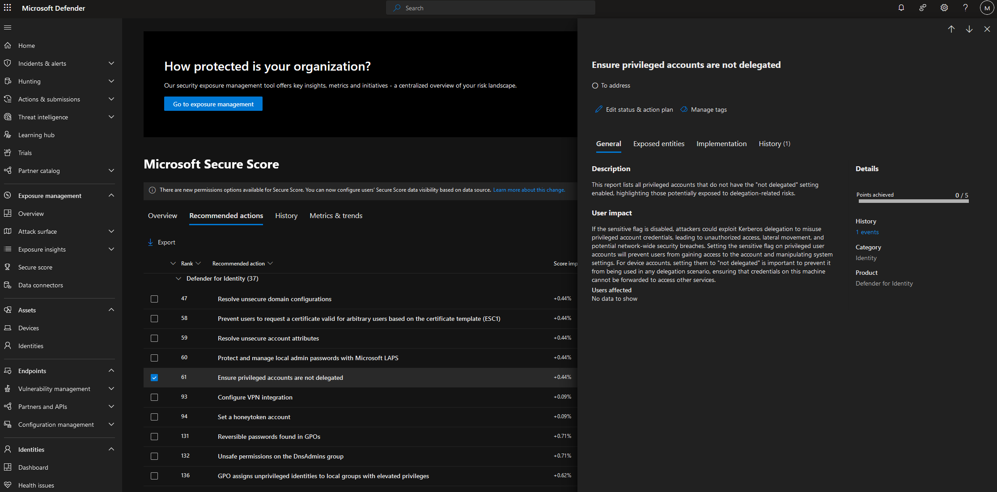

Slide 11
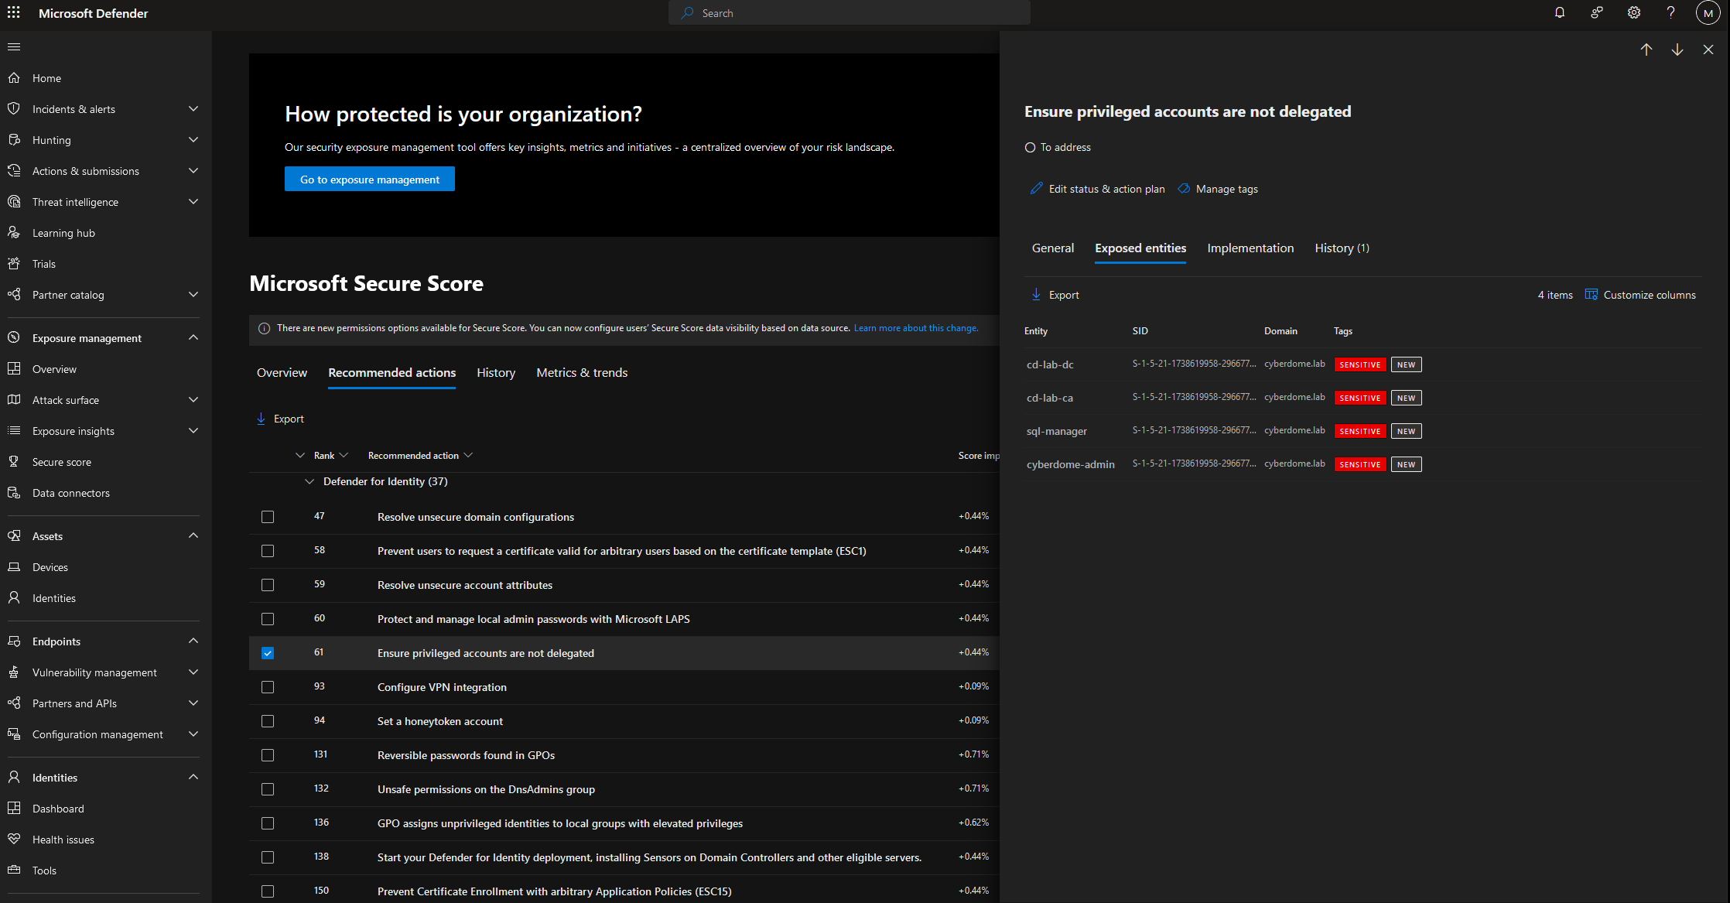

Slide 12
Identity Attack Example

Slide 13
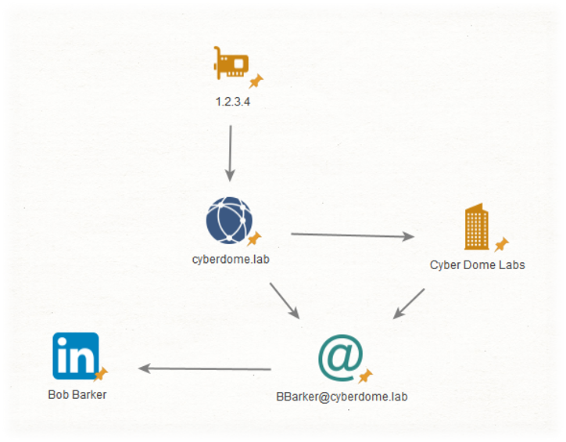
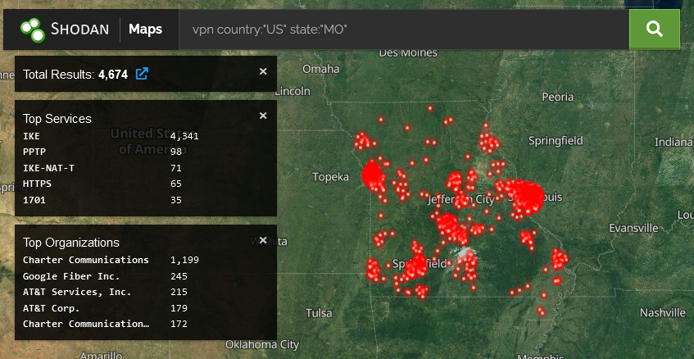
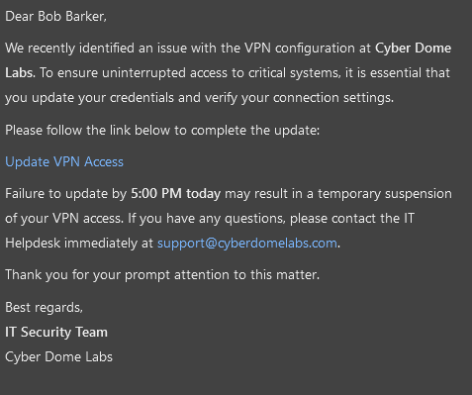


Slide 14
Kerberoasting Attack Example

Slide 15
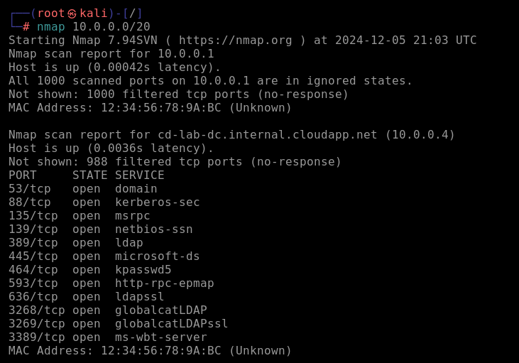
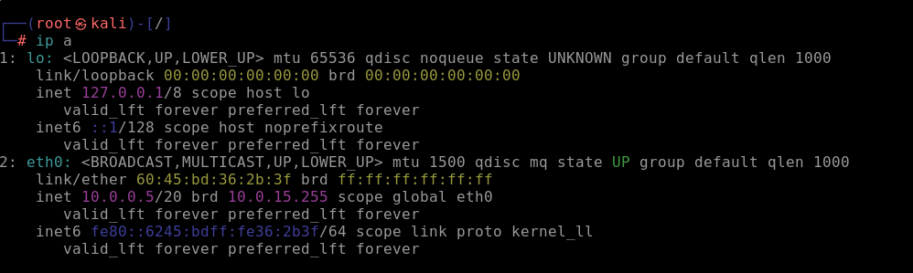
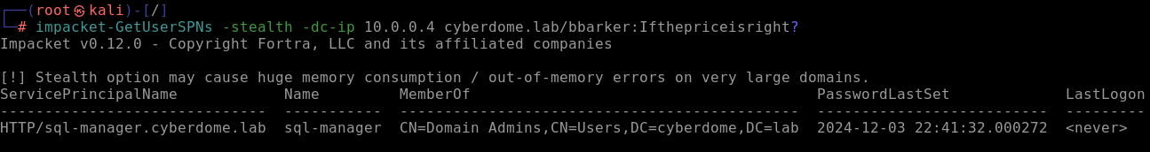

Slide 16
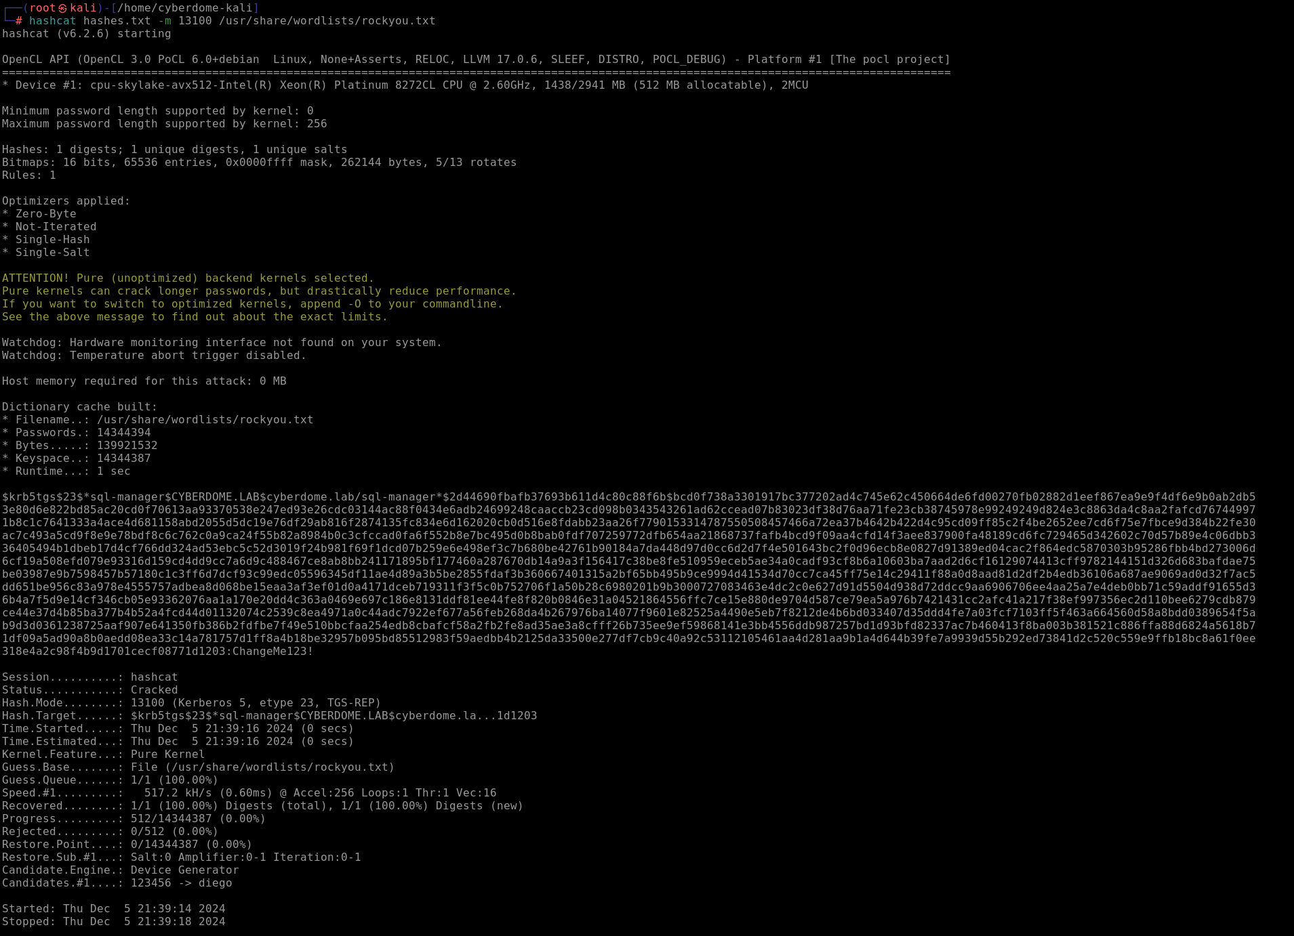
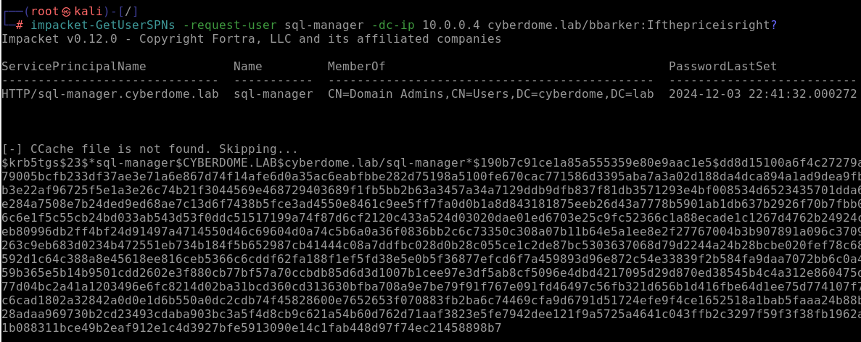

Slide 17
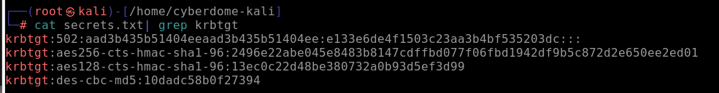
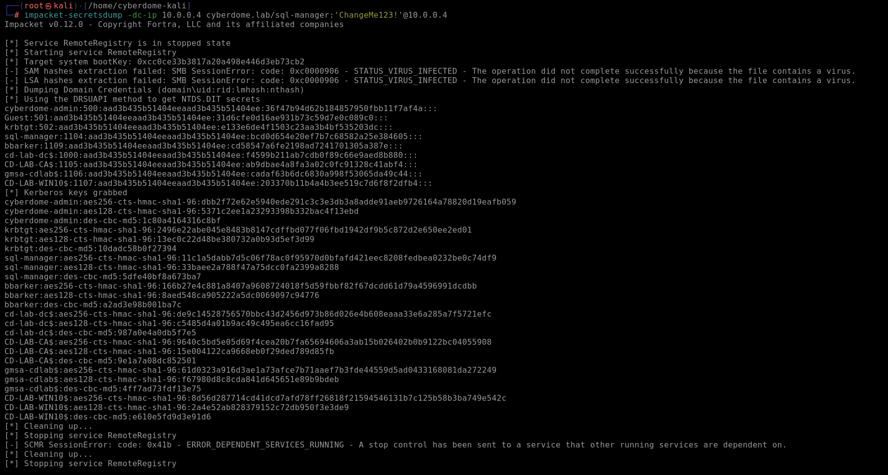
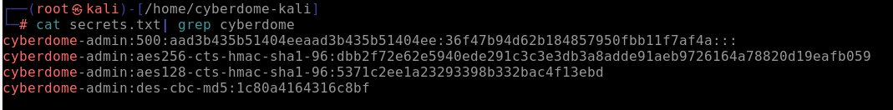
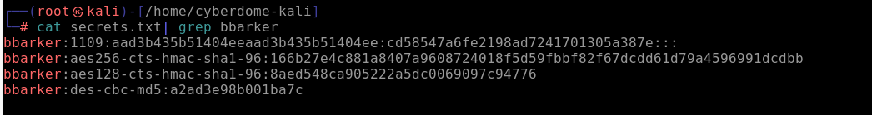
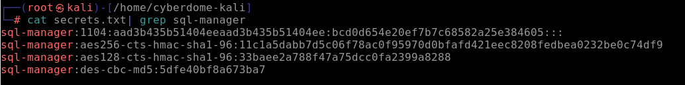

Slide 18
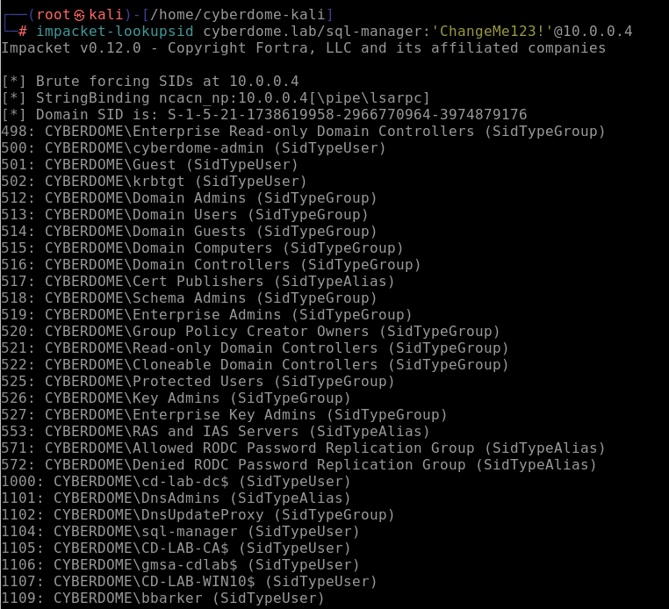


Slide 19
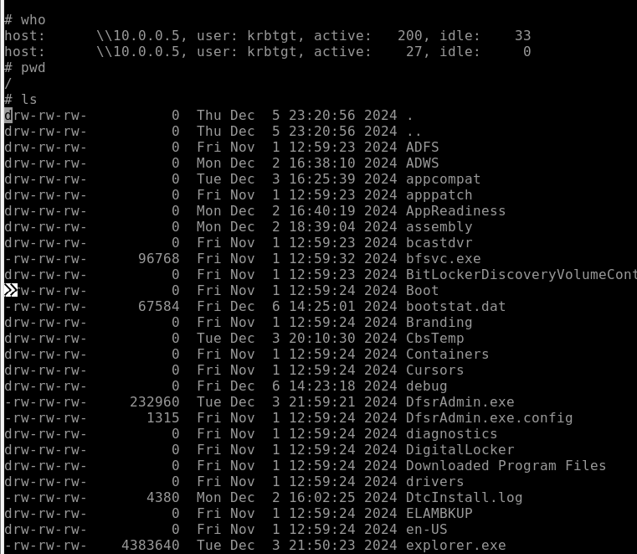
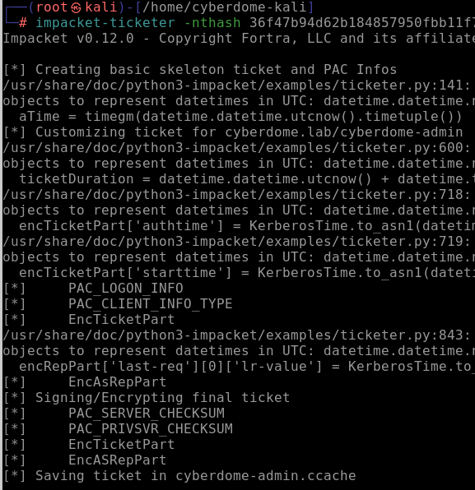

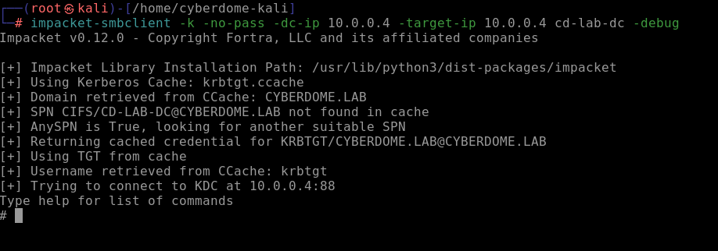
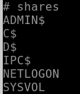
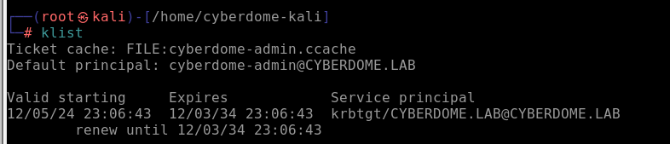

Slide 20
ESC1 and ESC8 attack example

Slide 21
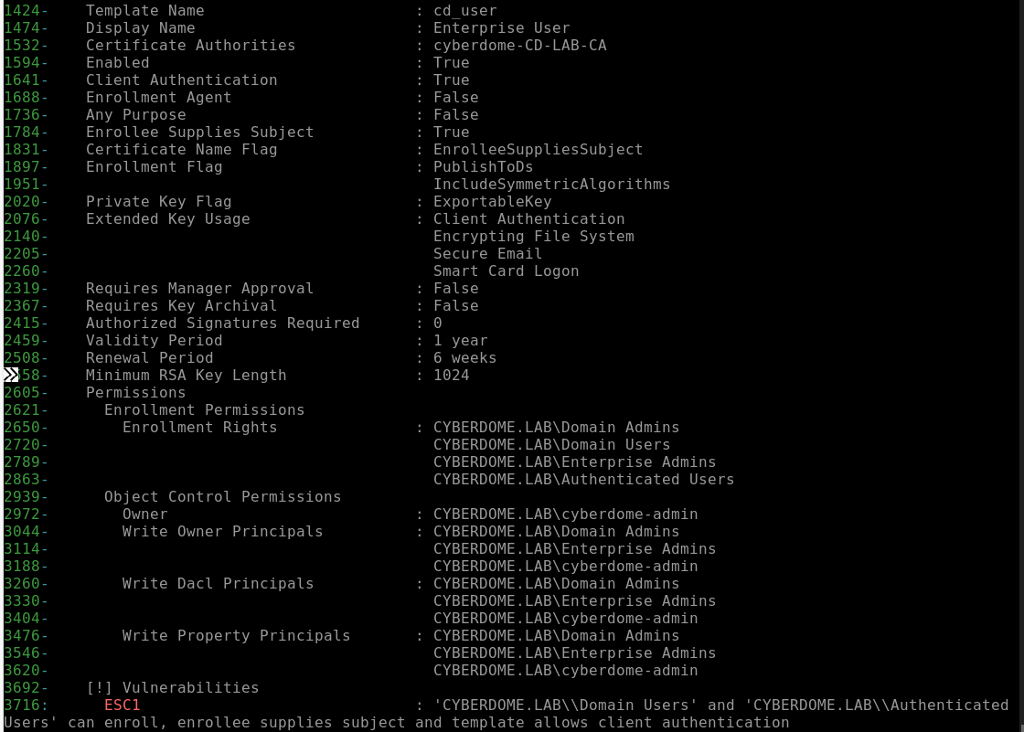
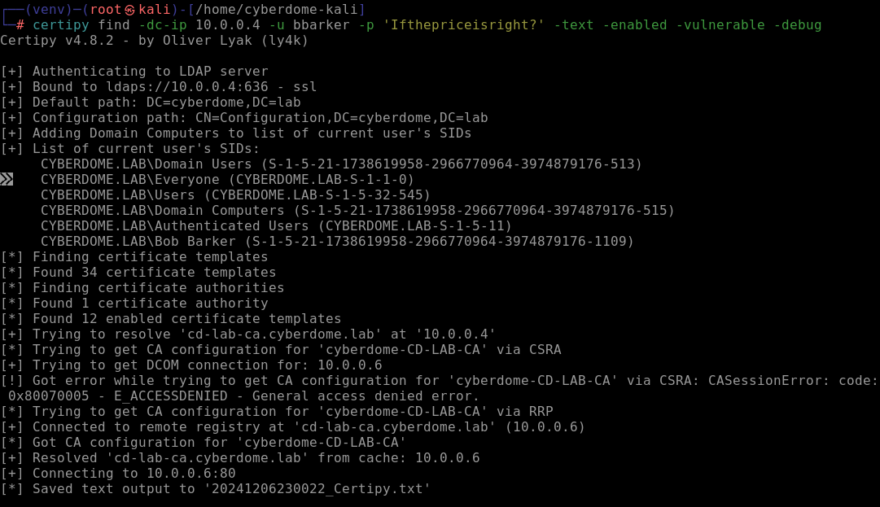
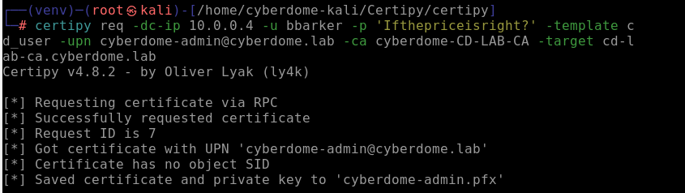
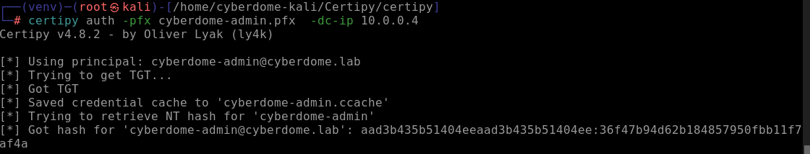
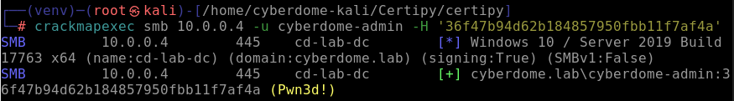

Slide 22
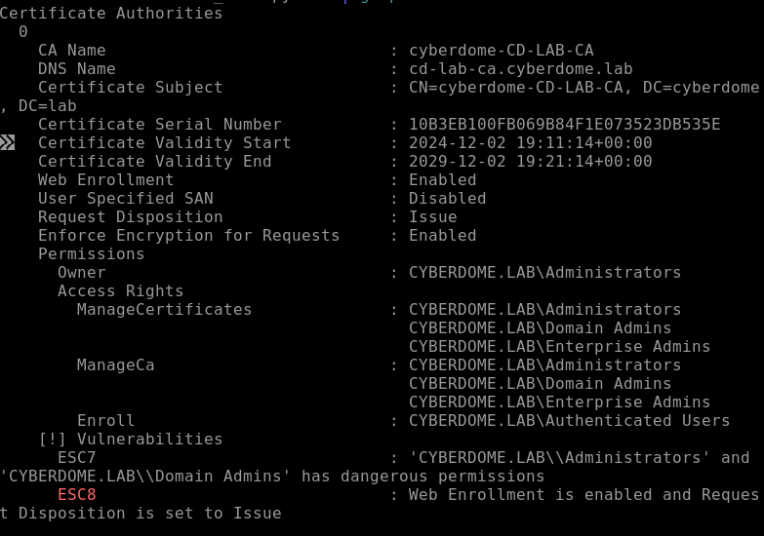
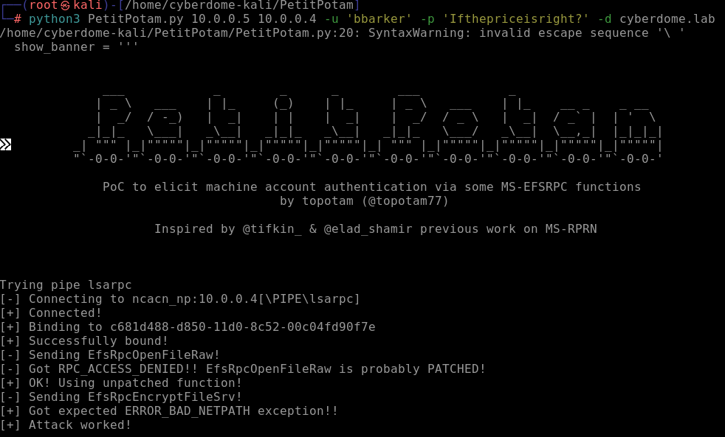
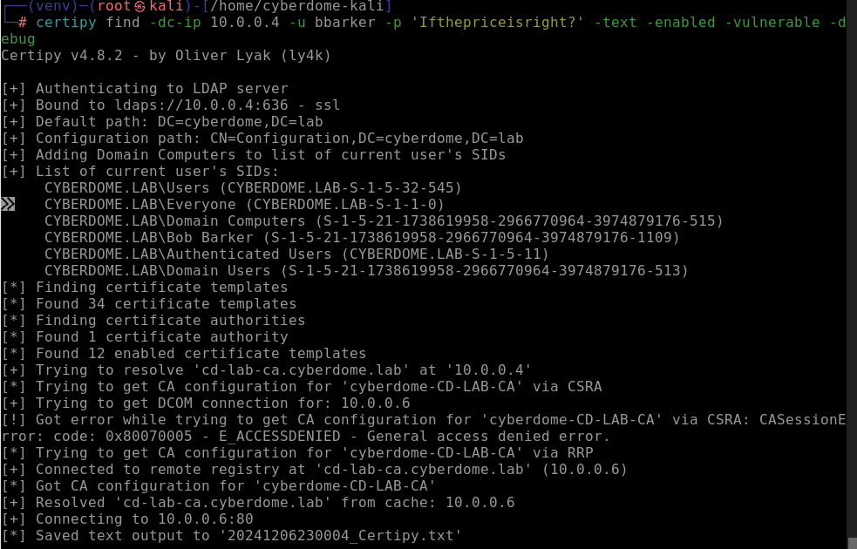
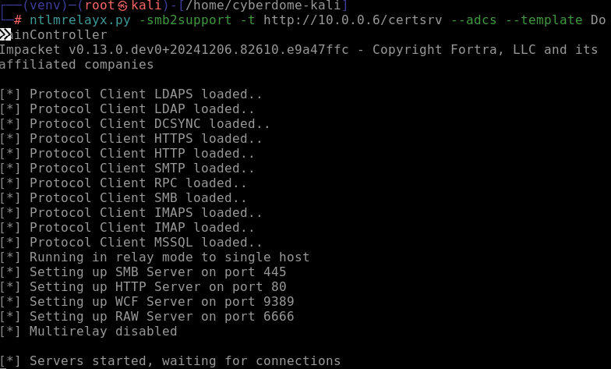
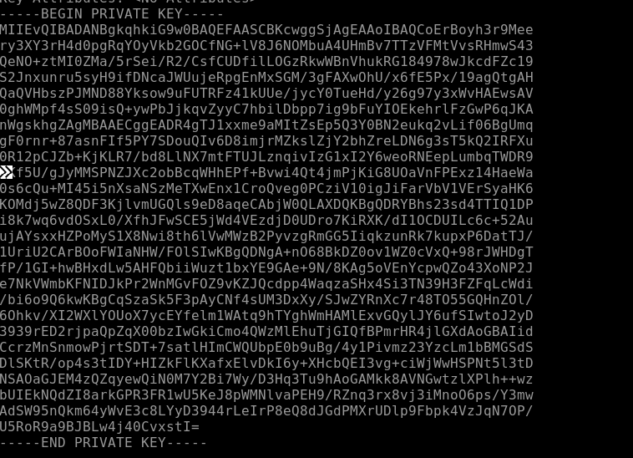
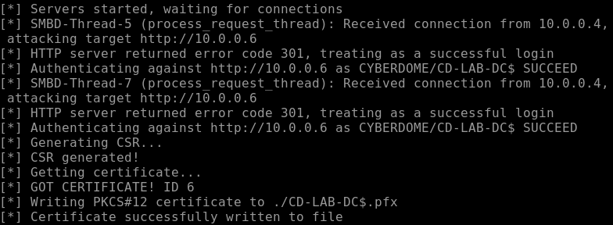

Slide 23
Preventing Attacks Against Active Directory

Slide 24
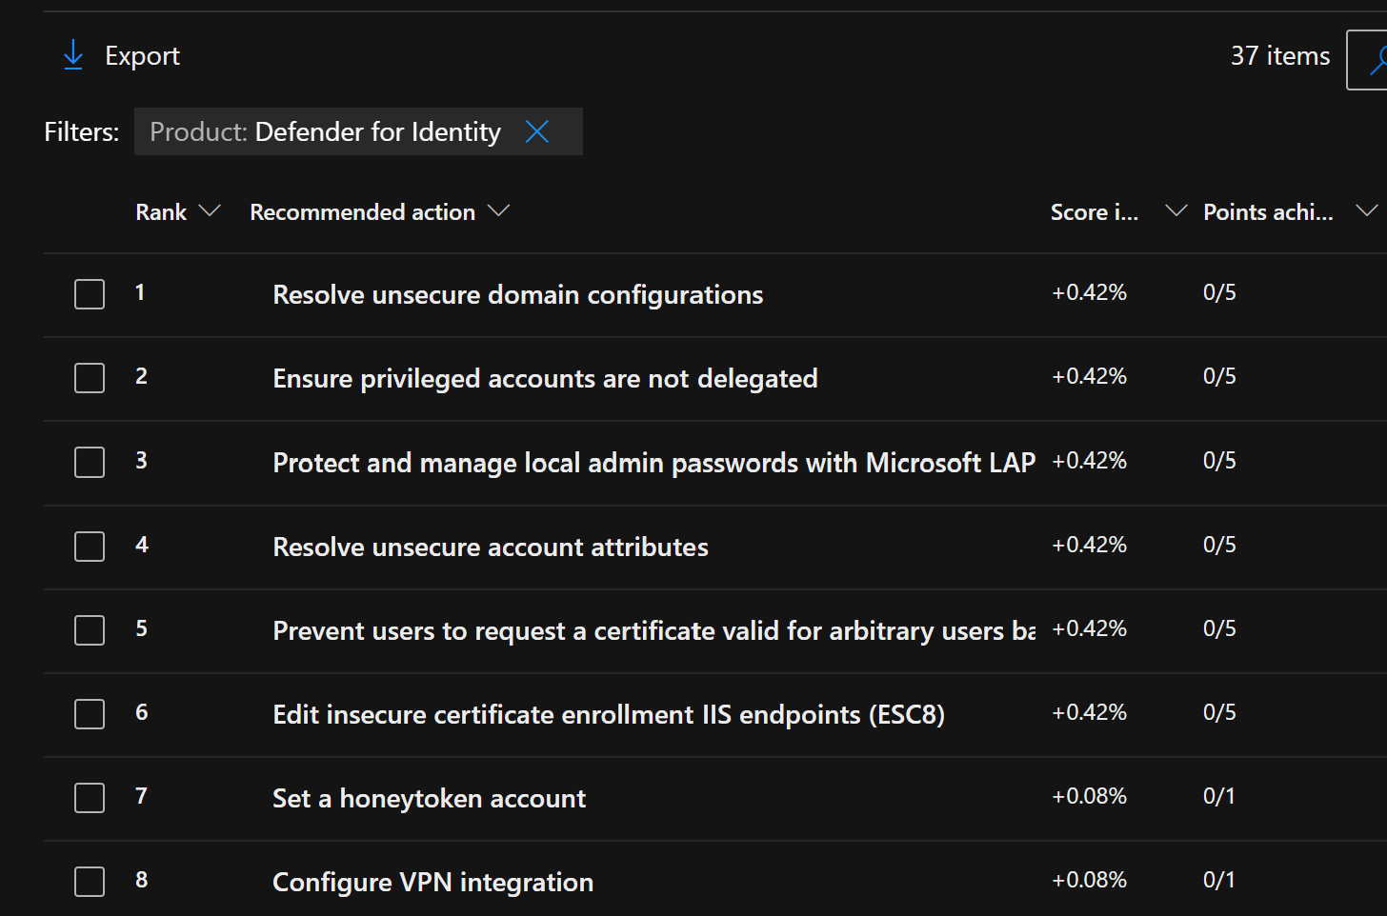
Secure Score
MDI will regularly scan your Active Directory environment to look for improvement actions.
Check often for changes – as your network changes new items may be found

Slide 25
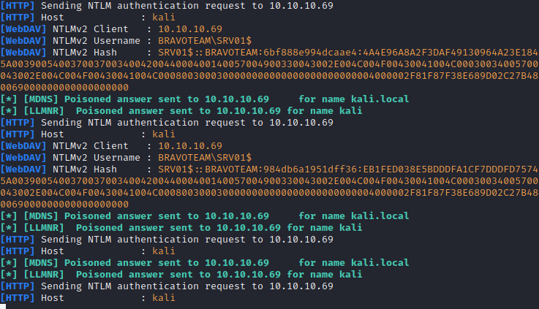
NTLM Hash Relay Prevention
Enforce signing where possible (LDAP and SMB)
Utilize device security features like credential guard
Where possible remove usage of NTLM in place of Kerberos

Slide 26
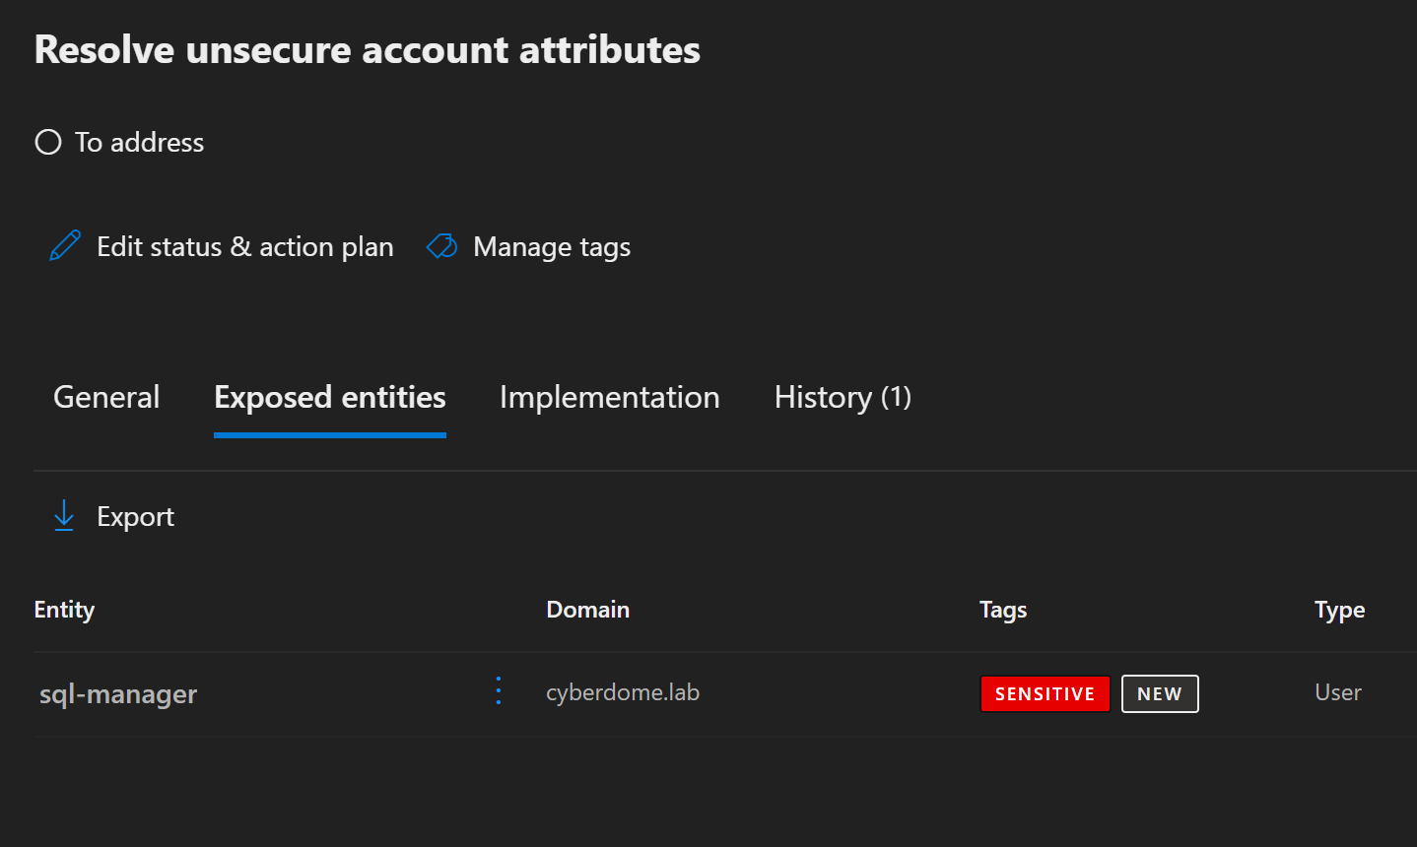
Keberoasting SPNs
Service Principal Names (SPNs) allow clients to quickly locate and authenticate to services on the network
Don’t attach Service Principal Names to user accounts with interactive login ability
Utilize Group Managed Service Accounts

Slide 27
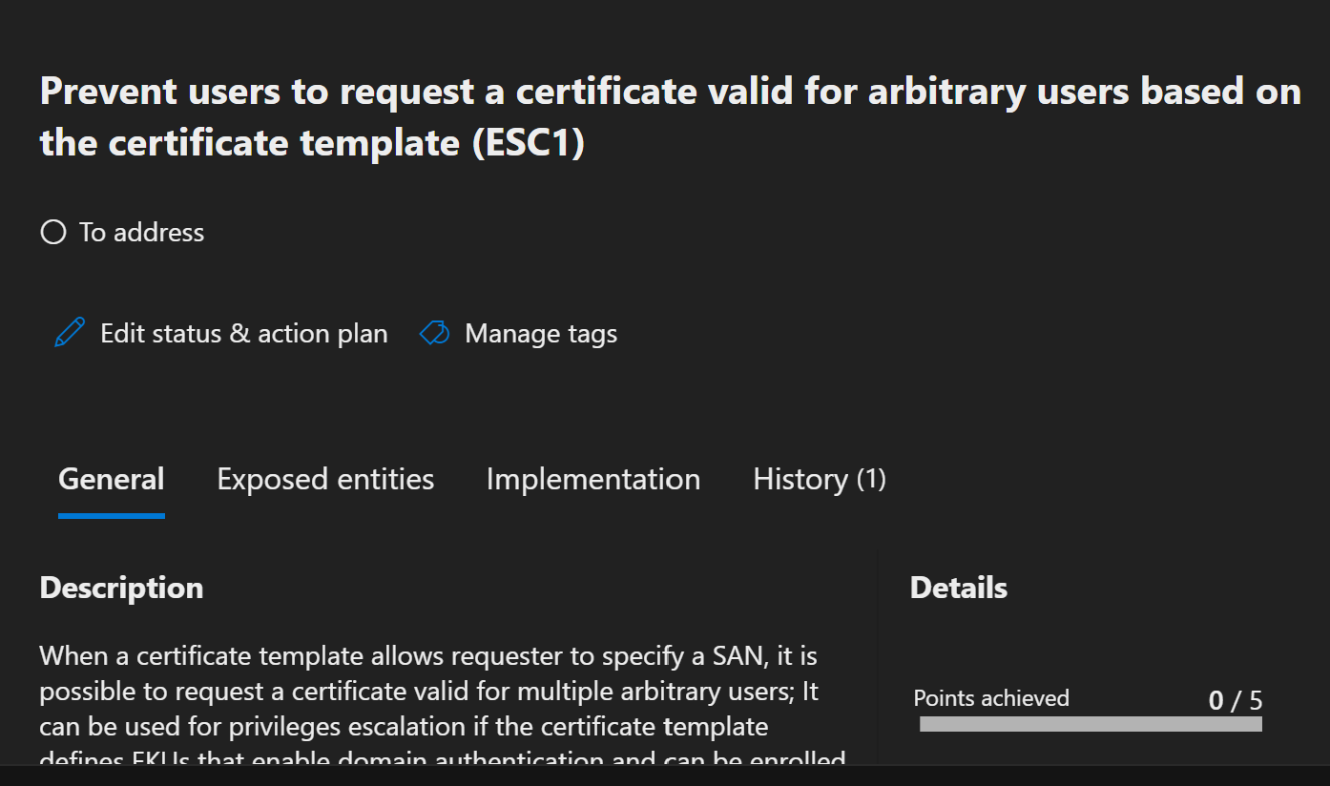
Certificate Vulnerabilities (ESC)
Misconfigurations in Active Directory Certificate services
Review templates for over-permissive settings
Enable auditing and install MDI sensor for detection

Slide 28

Matt Tindell (mtindell@aeci.org)
Tom Galloway (tgalloway@aeci.org)
Danny Dubree (ddubree@aeci.org)
www.aeci.org

