Slide 1


AMEC-ITA Annual Meeting 2024
Copyright © 2024 Associated Electric Cooperative, Inc. All Rights Reserved.
Notes:
In my tenure, I have not seen another technology that is more intriguing, risky, exciting, and full of questions.
Today, I will provide an overview of what AECI's research has led us to believe and understand about AI, what we're doing to prepare, and what the future will hold in AI.
Following this, we'll leave open some room for discussion, and Michael from Crawford Electric will provide some specific examples of how he's used AI.
I hope you all can learn something new from the following content. At Associated, I am part of a program team charged with building an AI program that is safe, secure, and sustainable. But where did we start?

Slide 2

The State of AI
Associated Electric Cooperative Inc.
Notes:
Gartner Research
Rapid advancements in AI technologies.
Increasing adoption across industries.
Growing questions about ethical use, capabilities, and risks.

Slide 3


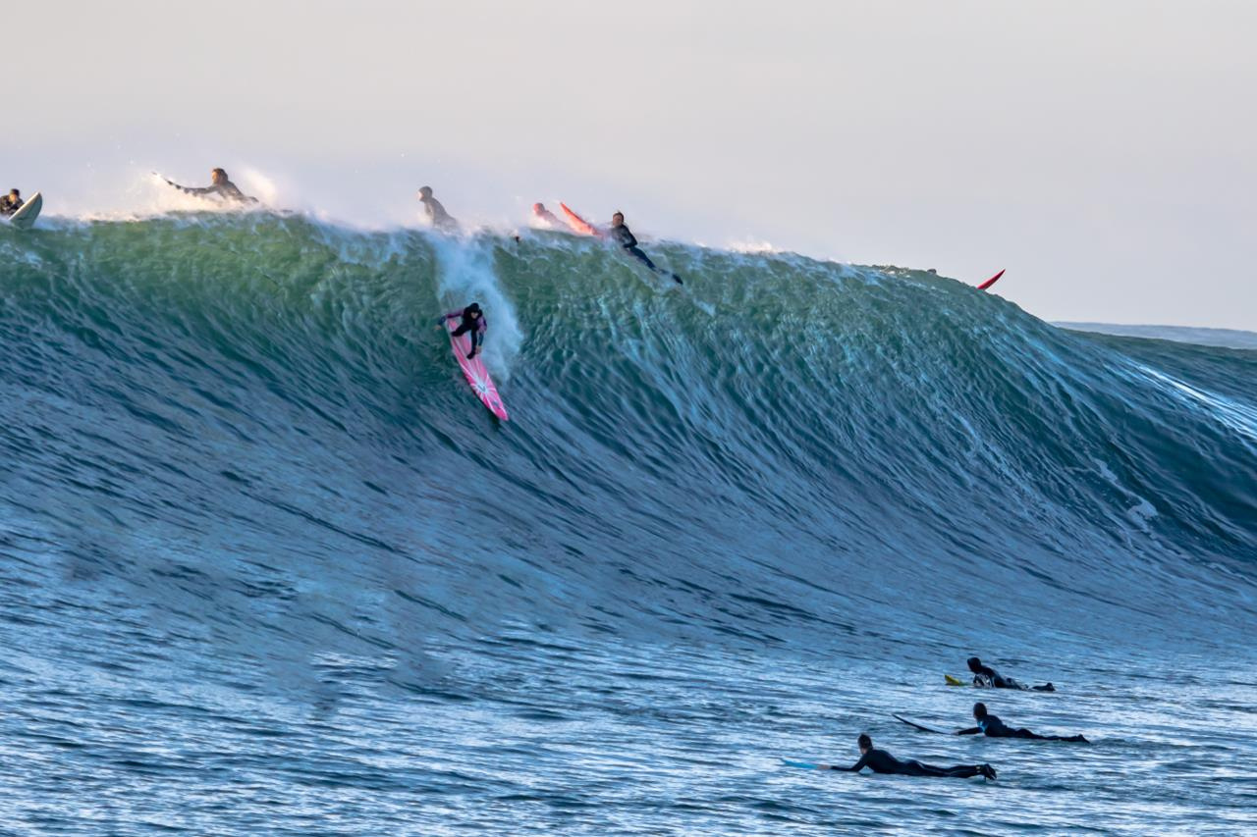


?
?
Notes:
Focus on GenAI for today’s presentation and discussion.
ASK Audience: raise your hand if you've used GenAI like ChatGPT?
GenAI: A transformative wave bringing both opportunities and uncertainties.
Questions: What is useful? What stays or goes?
Comparison to past disruptive technologies (e.g., the internet, smartphones).

Slide 4
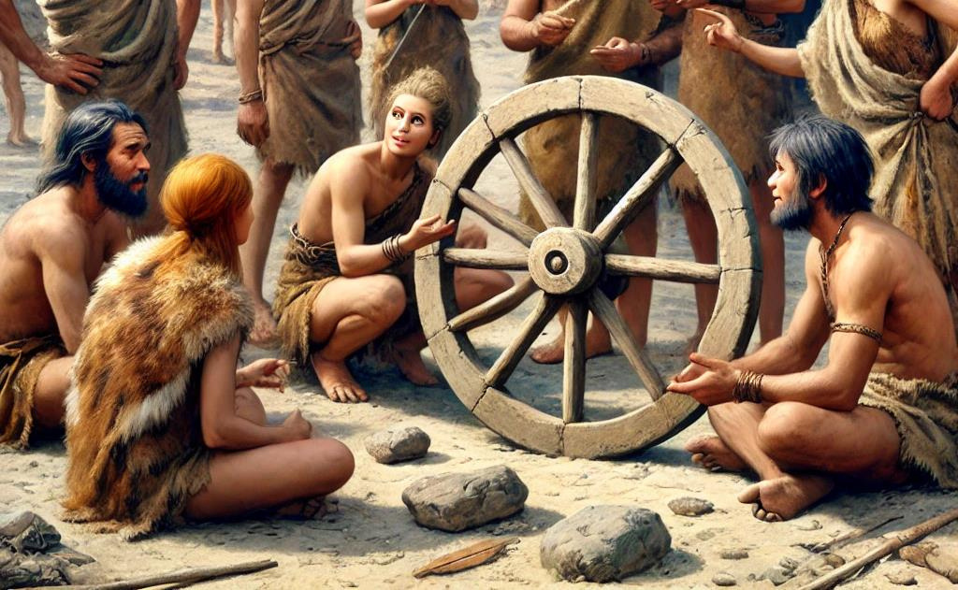

Notes:
Early conversations likely revolved around:
"How can this make life easier?"
"What are the risks or limitations?"
"Who will use it, and how?"

Slide 5
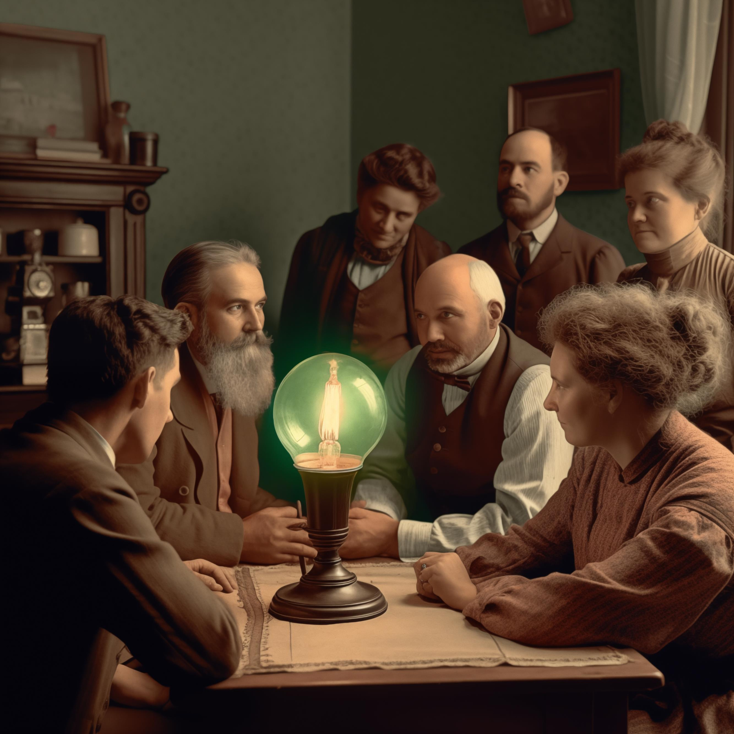

Notes:
Discussions about:
Practical applications (lighting homes, cities).
Overcoming challenges (cost, safety).
Potential societal impact.

Slide 6
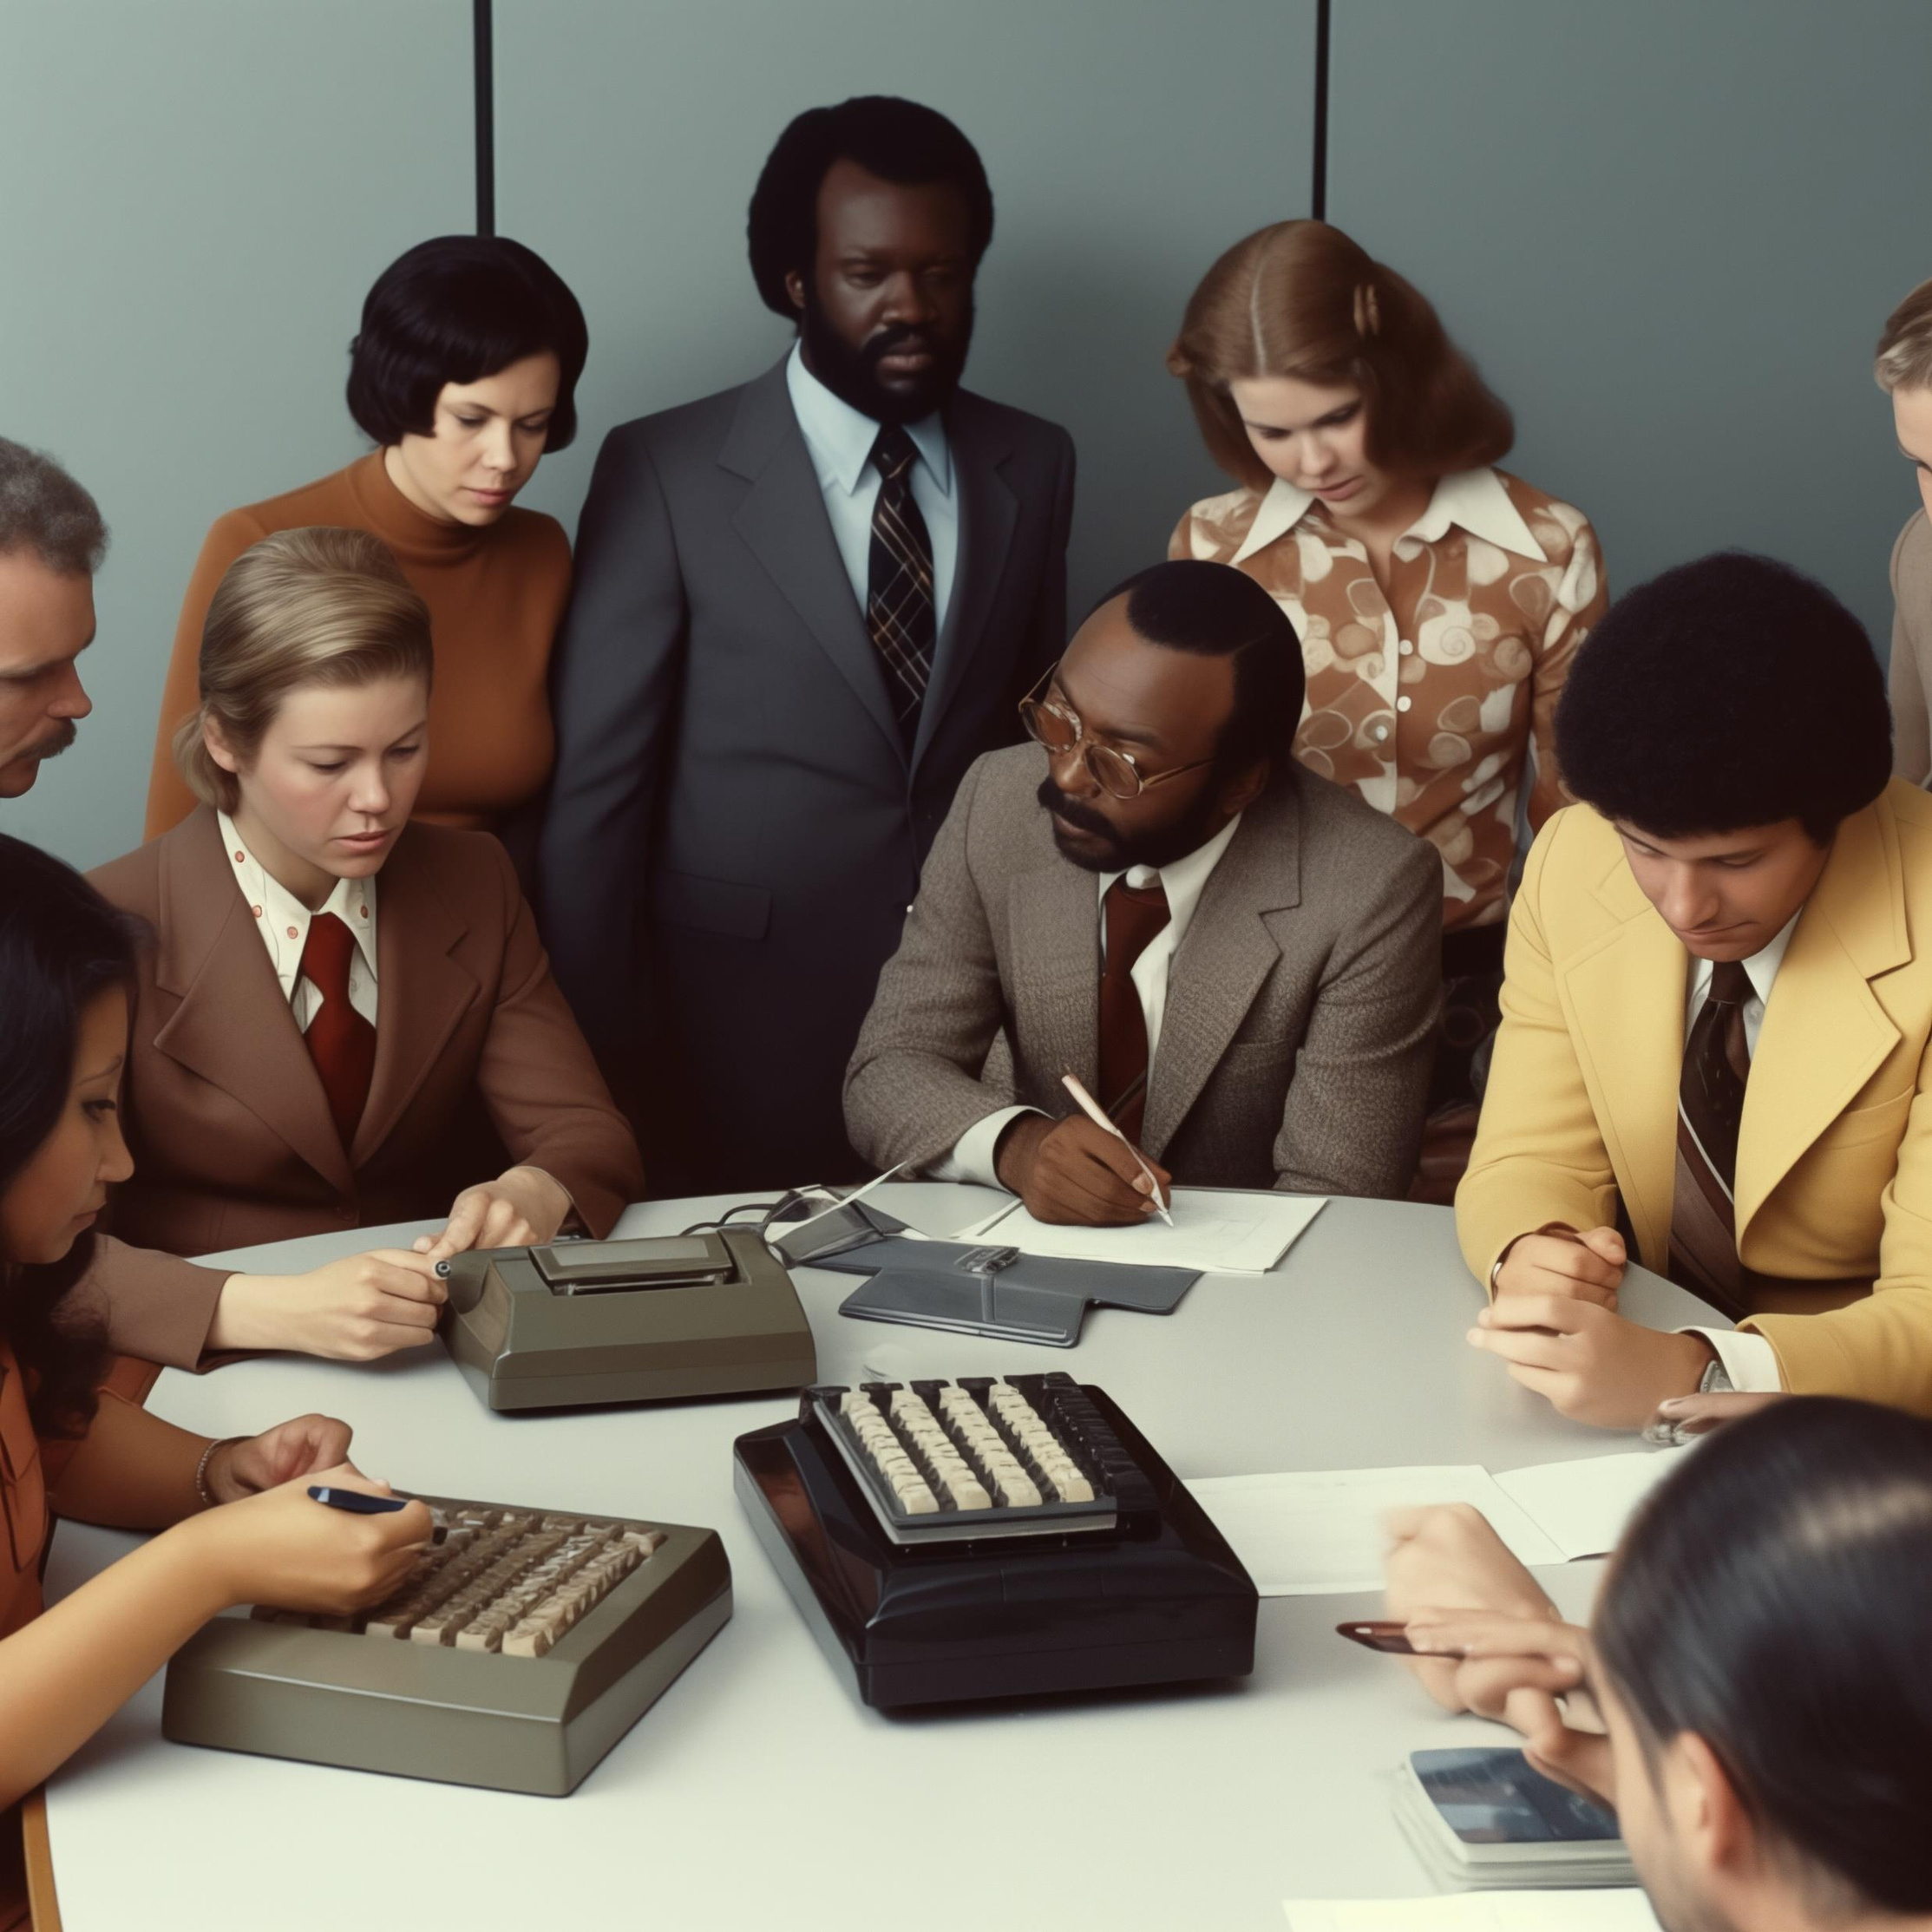

Notes:
Topics might have included:
Enhancing efficiency in calculations.
Use cases in science, education, and finance.
Concerns about dependency or accessibility.

Slide 7
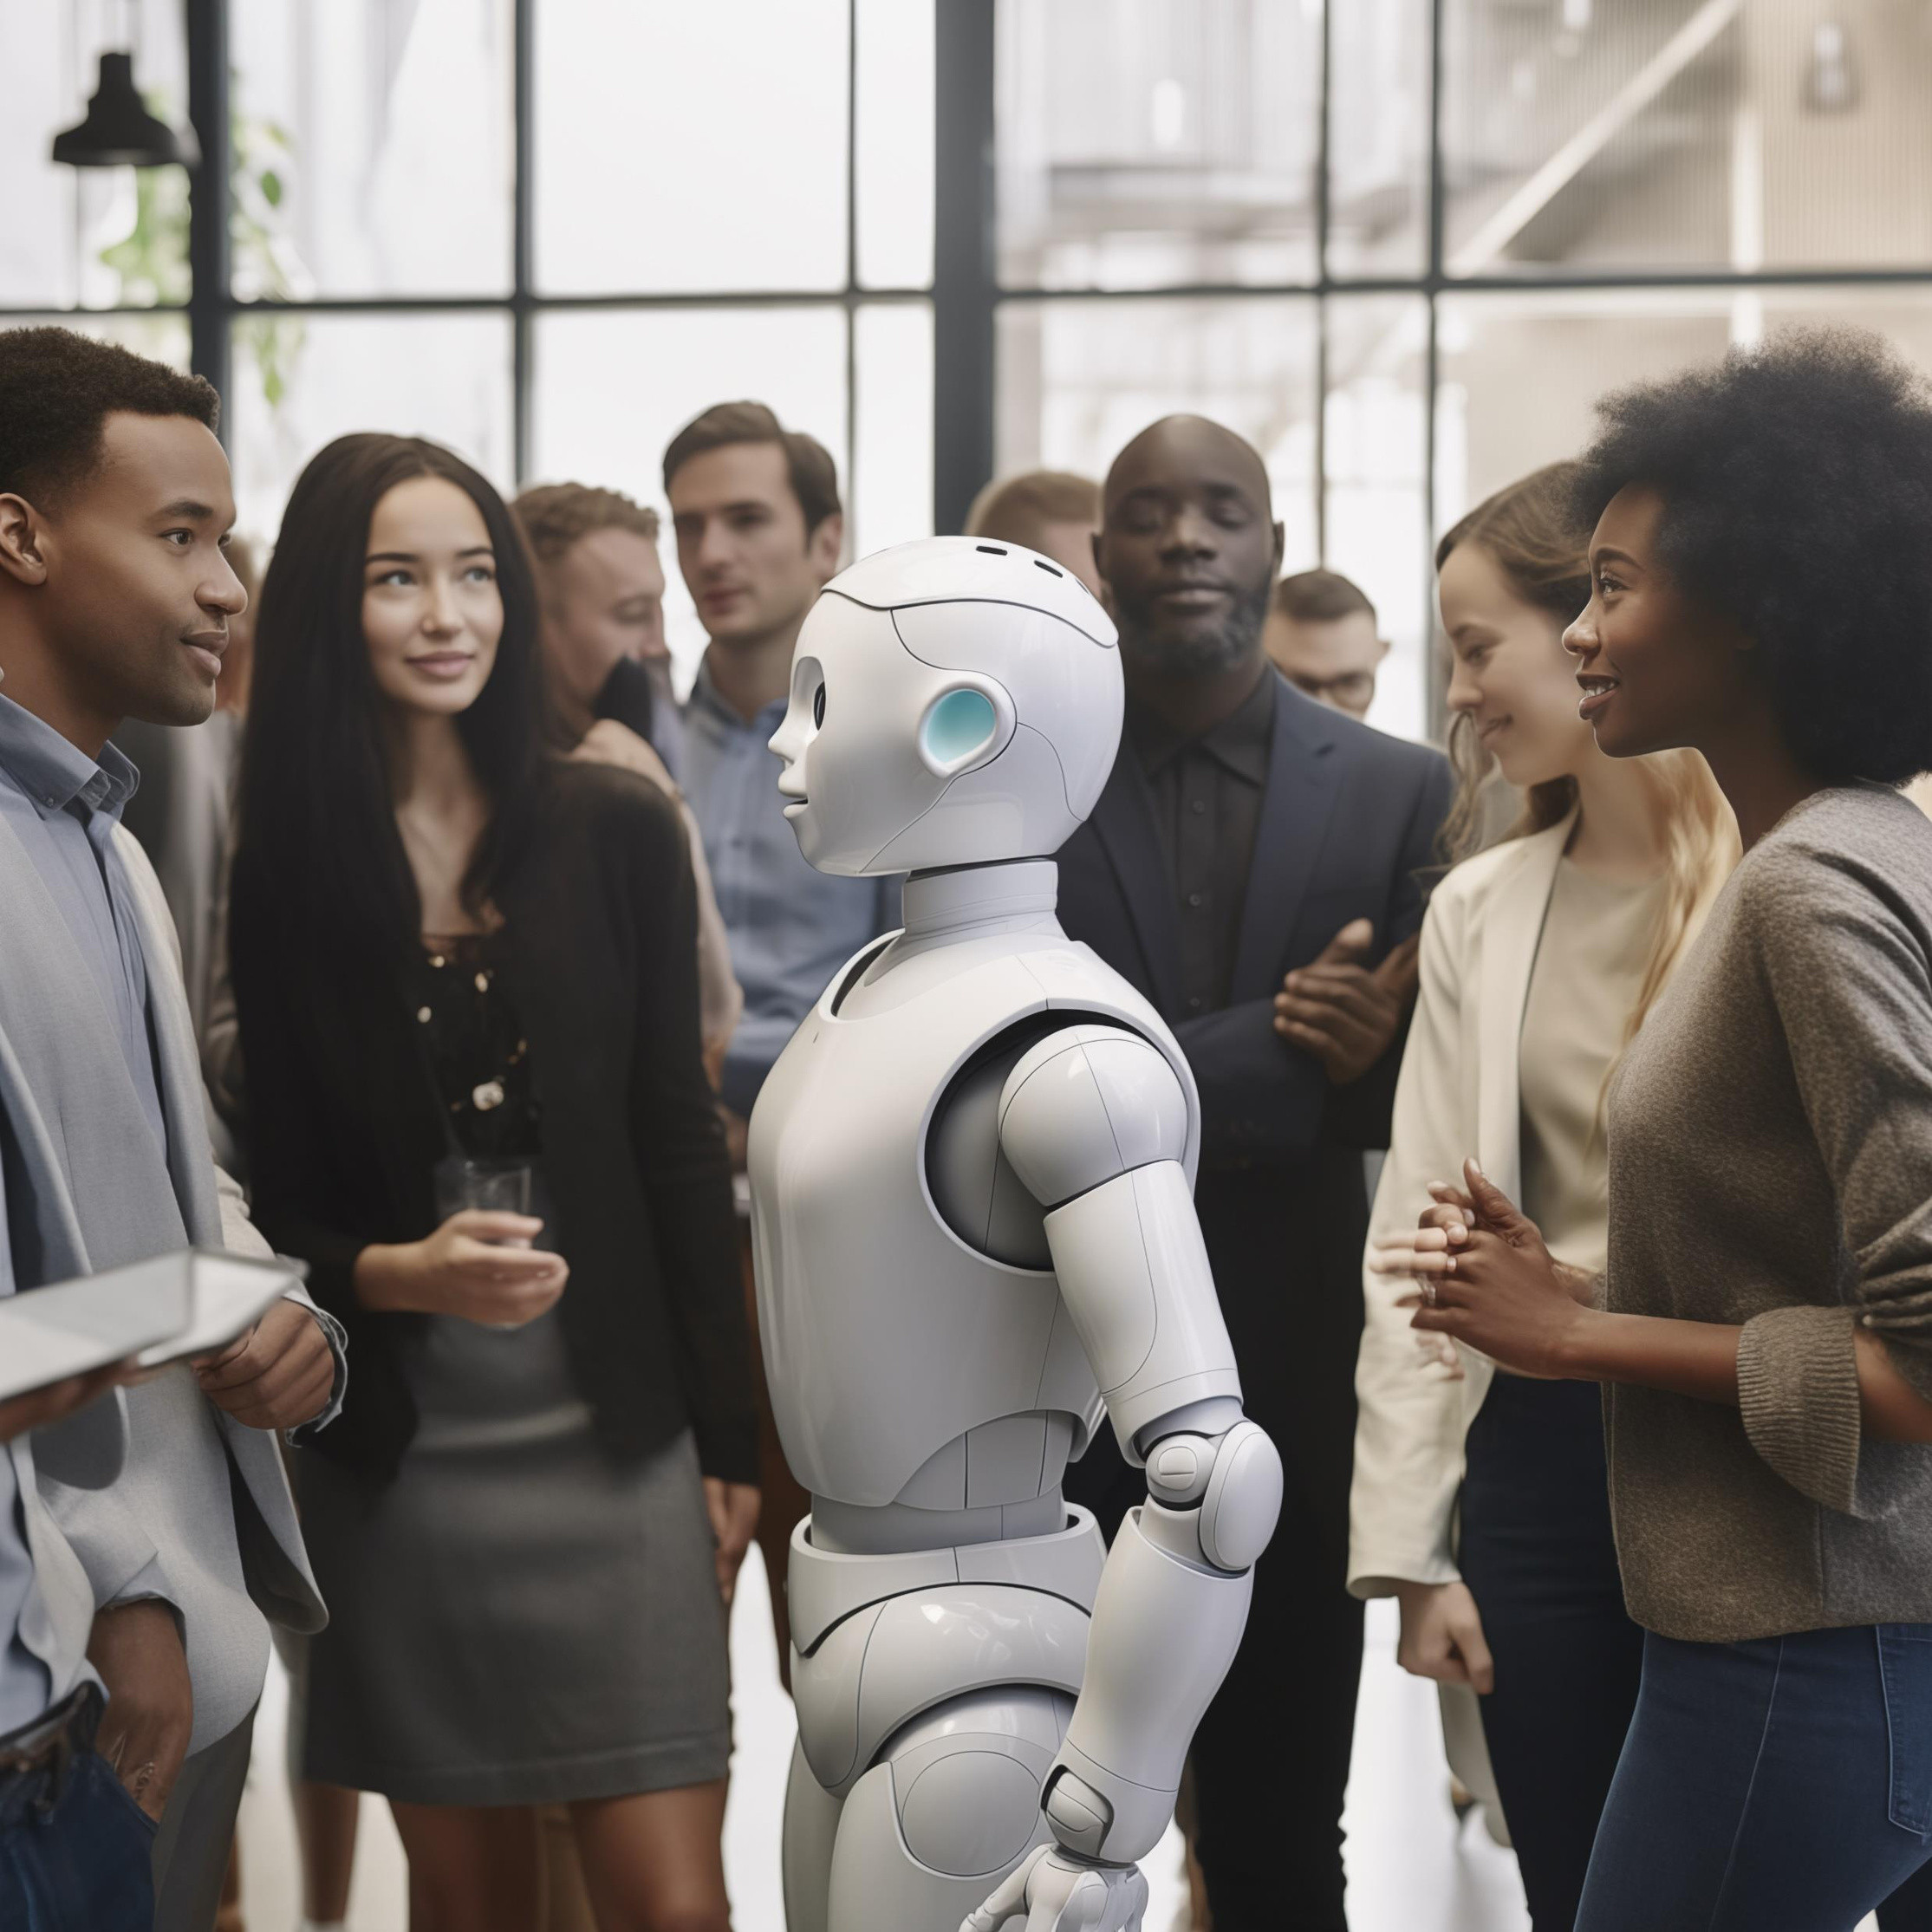

Notes:
Today’s conversations echo past technological revolutions.
Key themes: opportunities, limitations, ethical concerns.

Slide 8
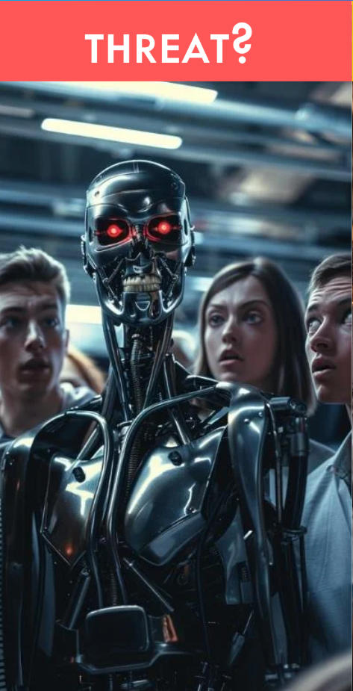
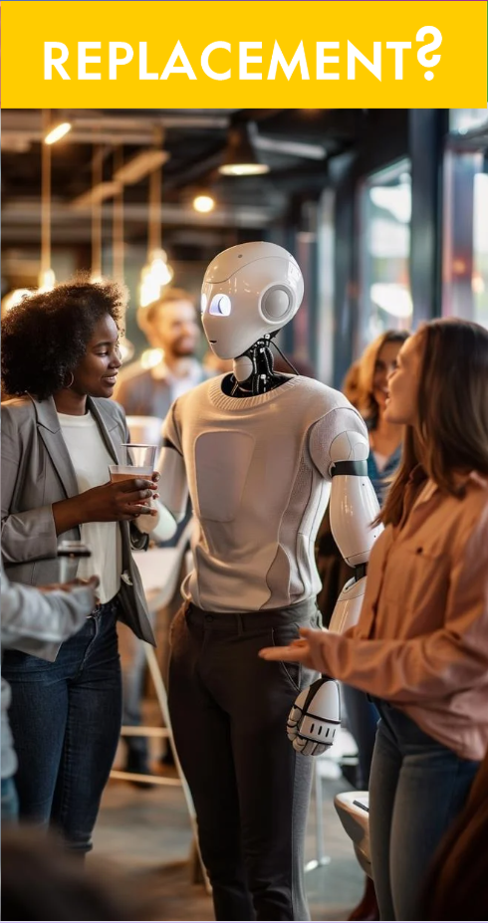
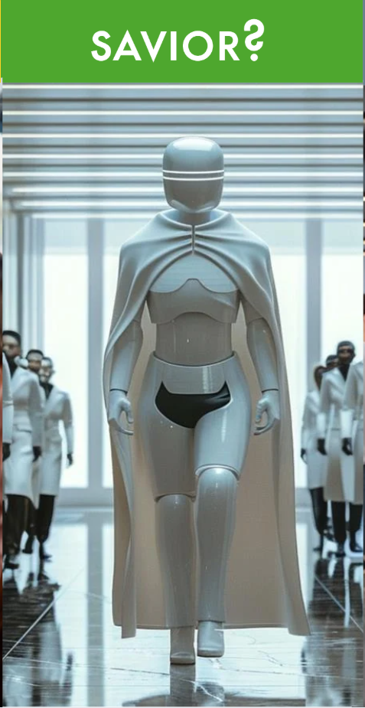
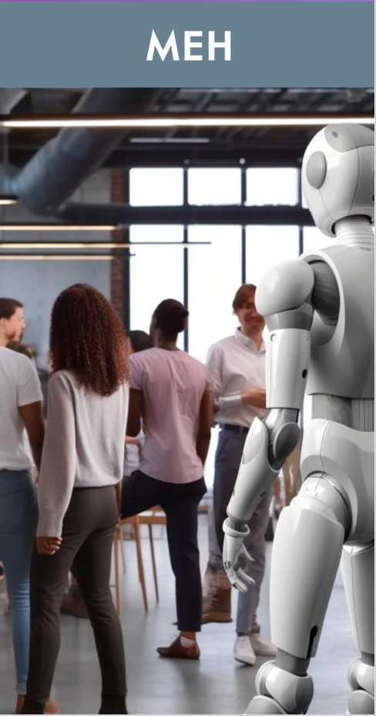
Notes:
Threat? Replacement? Savior? Dismissed as a trend?
Threat - Terminator, eleminate humans
Replacement - here to take our jobs and leave us out to dry
Savior - we'll work but 2 hours a week, while having our Robots build, cook, entertain, and run society for us so we can enjoy the beach
Meh - is it just trendy now and not worth anything in the end

Slide 9






Notes:
GenAI transforms how expertise is accessed and shared.
Makes skills and knowledge portable across contexts.

Slide 10



Notes:
Inputs and training data: the foundation of GenAI’s learning.
Models process and generate predictions, continually improving.

Slide 11











Input Data
Model
Output
(Prediction)
Model Training
Training Data
Notes:
Let’s break this down:
First, we have input data, which is fed into the model.
The model processes this input to generate a prediction or output.
These predictions are then used to improve the model through a feedback loop, making it smarter over time.
All of this relies on high-quality training data to ensure the model’s accuracy and reliability.
Think of it as a continuous cycle of learning and refining.

Slide 12


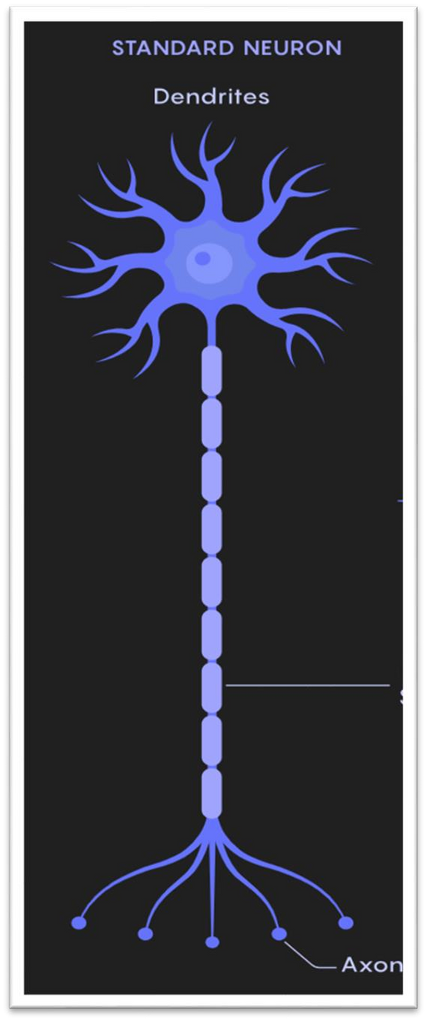



Notes:
Inspired by the human brain’s neural structures.
Ability to identify patterns, relationships, and context.

Slide 13


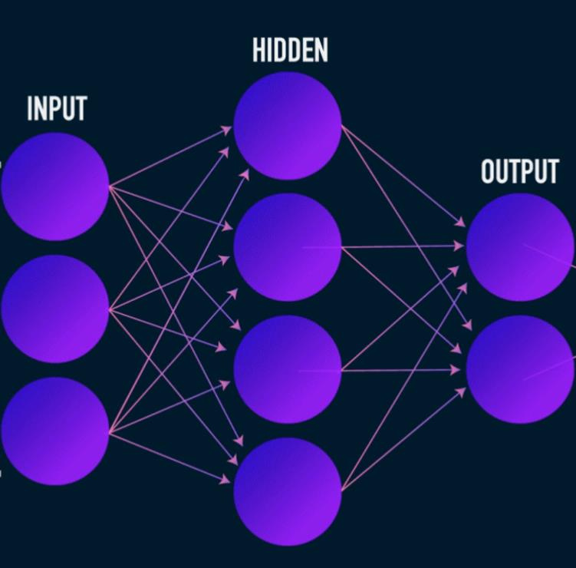

Notes:
Let’s unpack this:
Tokens are the smallest pieces of information the model understands. Think of them as individual words or parts of words.
Parameters are like the settings or weights in the model that help it make accurate predictions. The more parameters, the more nuanced the model’s understanding.
Training is the process of teaching the model by exposing it to vast amounts of data so it can learn patterns and improve its performance over time.
Together, these elements form the backbone of how neural networks function and improve.

Slide 14

















Notes:
GPT-2 marked a turning point in AI by demonstrating how scaling parameters could significantly improve language generation and understanding.
GPT-3 "broke the internet" in November 2022 with the launch of ChatGPT, showing unprecedented conversational AI capabilities.
GPT-4 is today’s leading model, known for its incredible capabilities, including nuanced understanding, multi-modal input processing, and performing complex tasks with human-like accuracy.
Notice too not just exponential capabilities but cost to train in dollars and energy; notably these costs are only to train the model for primetime use - not everyday operations

Slide 15











Notes:
GPT-5 is wildly debated on actual costs it will take, but assuming a 10x multiplier we can make some guesses, but hoping that the latest breakthroughs in AI computing will vastly reduce the energy consumption compared to today
Thought Experiment: if we lined up the time to conduct the training serially, it would take 34,000 years to train
I bring that up to tell you all that you shouldn't be worried about AI taking over because YOU are a much cheaper alternative

Slide 16









Notes:
Taking about 22 years and $200,000 with only roughly 17Mwh

Slide 17
Associated Electric’s AI Program
Mission
Our mission is to amplify human potential in the organization, giving everyone access to new avenues of capability, productivity, creativity, and insight through GenAI technology in their products and platforms.
Associated Electric Cooperative Inc.
Notes:
Amplify human potential through GenAI.

Slide 18

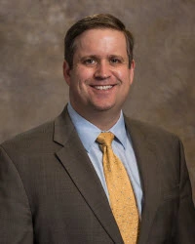
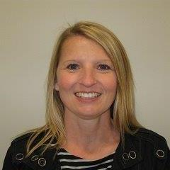
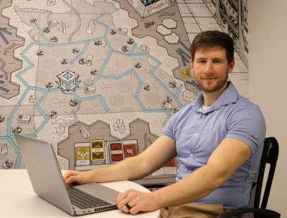




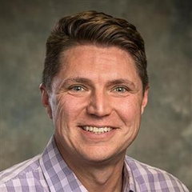
Our Team
Charlie Evans
Brian Prestwood
Tammy Mason
Anthony Lonigro
AI Program Team Lead
CCR, Exec Champion
Human Resources
IT User SME
Robin Harrison
Dayna Havemann
Danny Dubree
Jared Newhart
Justin Kosar
Communications
A&F User SME
Security & IAM
Gen AI Program Lead
Machine Language Lead
Notes:
Cross-cutting team of many perspectives and expertise to ensure a well rounded representation and course direction.

Slide 19









AI Program Team Objectives
Human Resources
Ethical and Fair Use of AI Workforce Planning & Development
Legal
AI Policy Mitigation of Legal Risk
Information Services
AI Platform Selection Effective AI Adoption
Associated Electric Cooperative Inc.
Notes:
If we approached this as just another IT application, we would do the IS work
BUT, we have much more to consider. HR and Legal are paramount to success, and mitigation of risk

Slide 20
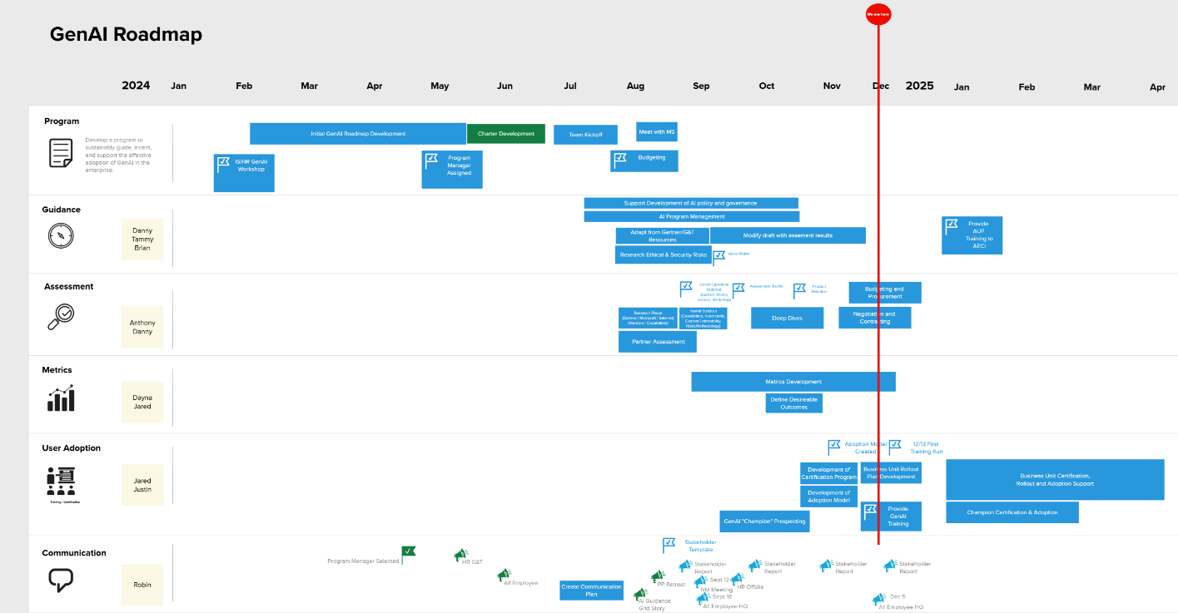
Notes:
Here is an overview of our progress and organization
We started small subgroups of workshops for learning while our program manager developed a roadmap and charter
Since July we have been hard at work in building guidance, assesting the best fit product, developing necessary metrics and a training program for our users - all why ensuring we keep our company in the know of whats to come next

Slide 21
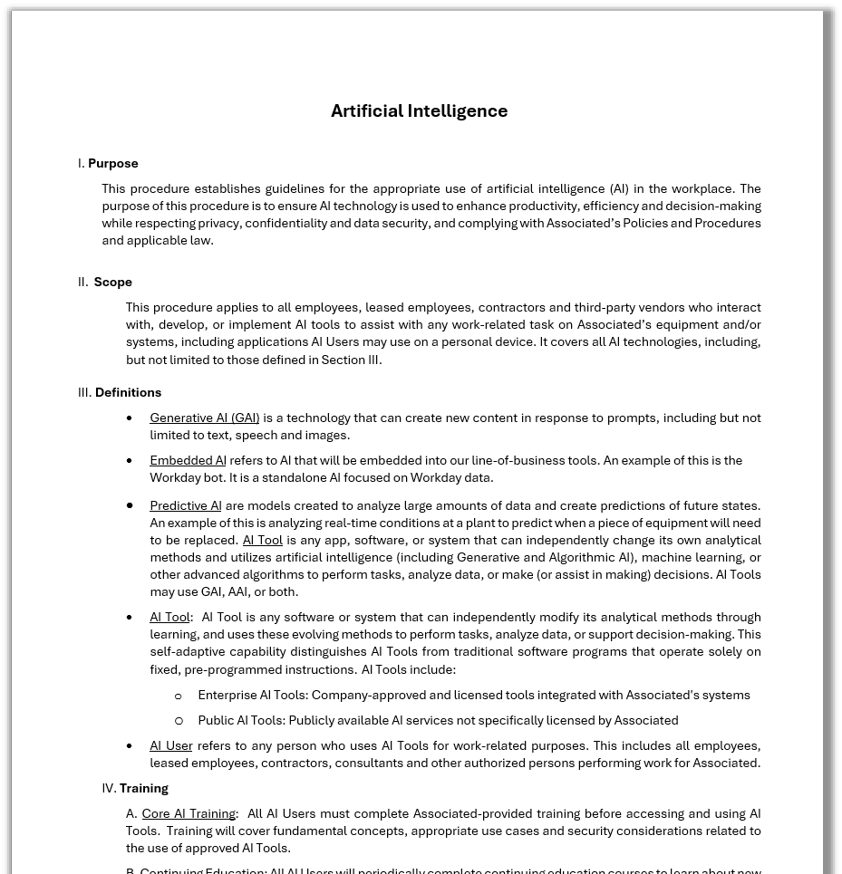



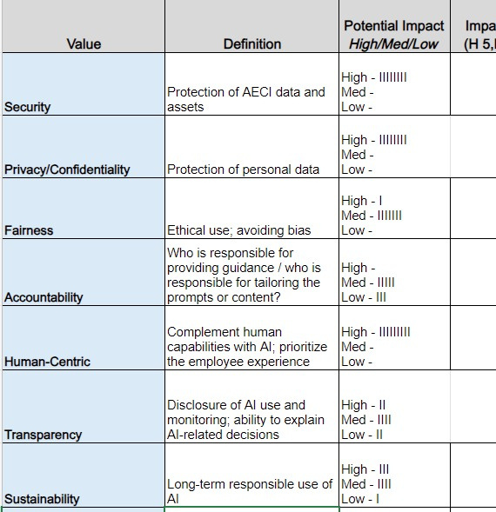
Guidance –
Empowering Users
Peer’s Policies
Gartner Best Practices
AECI Values
Human-Centric
Final Draft
Associated Electric Cooperative Inc.
Notes:
We reviewed industry peers' policies
We Utilized Gartner
After many iterations, we found that a human-centric approach ensures guidelines are practical, relatable, and focused on meaningful outcomes
This ensures you are writing to other humans and holding them to said expectations
Today - Our AI guidelines are in final draft, pending executive review.

Slide 22
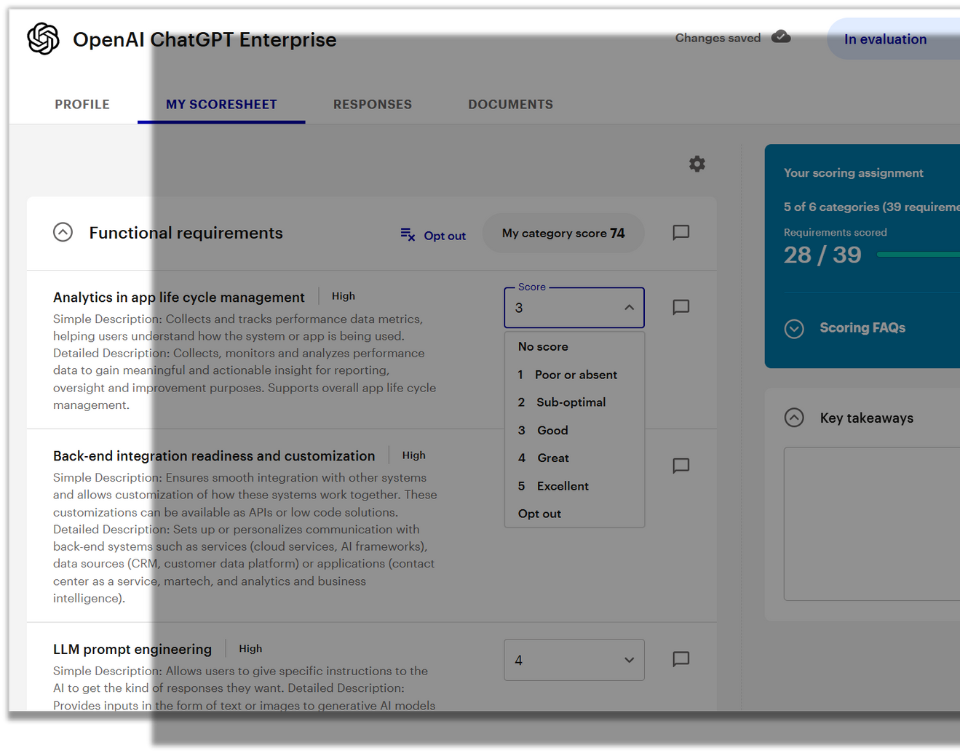


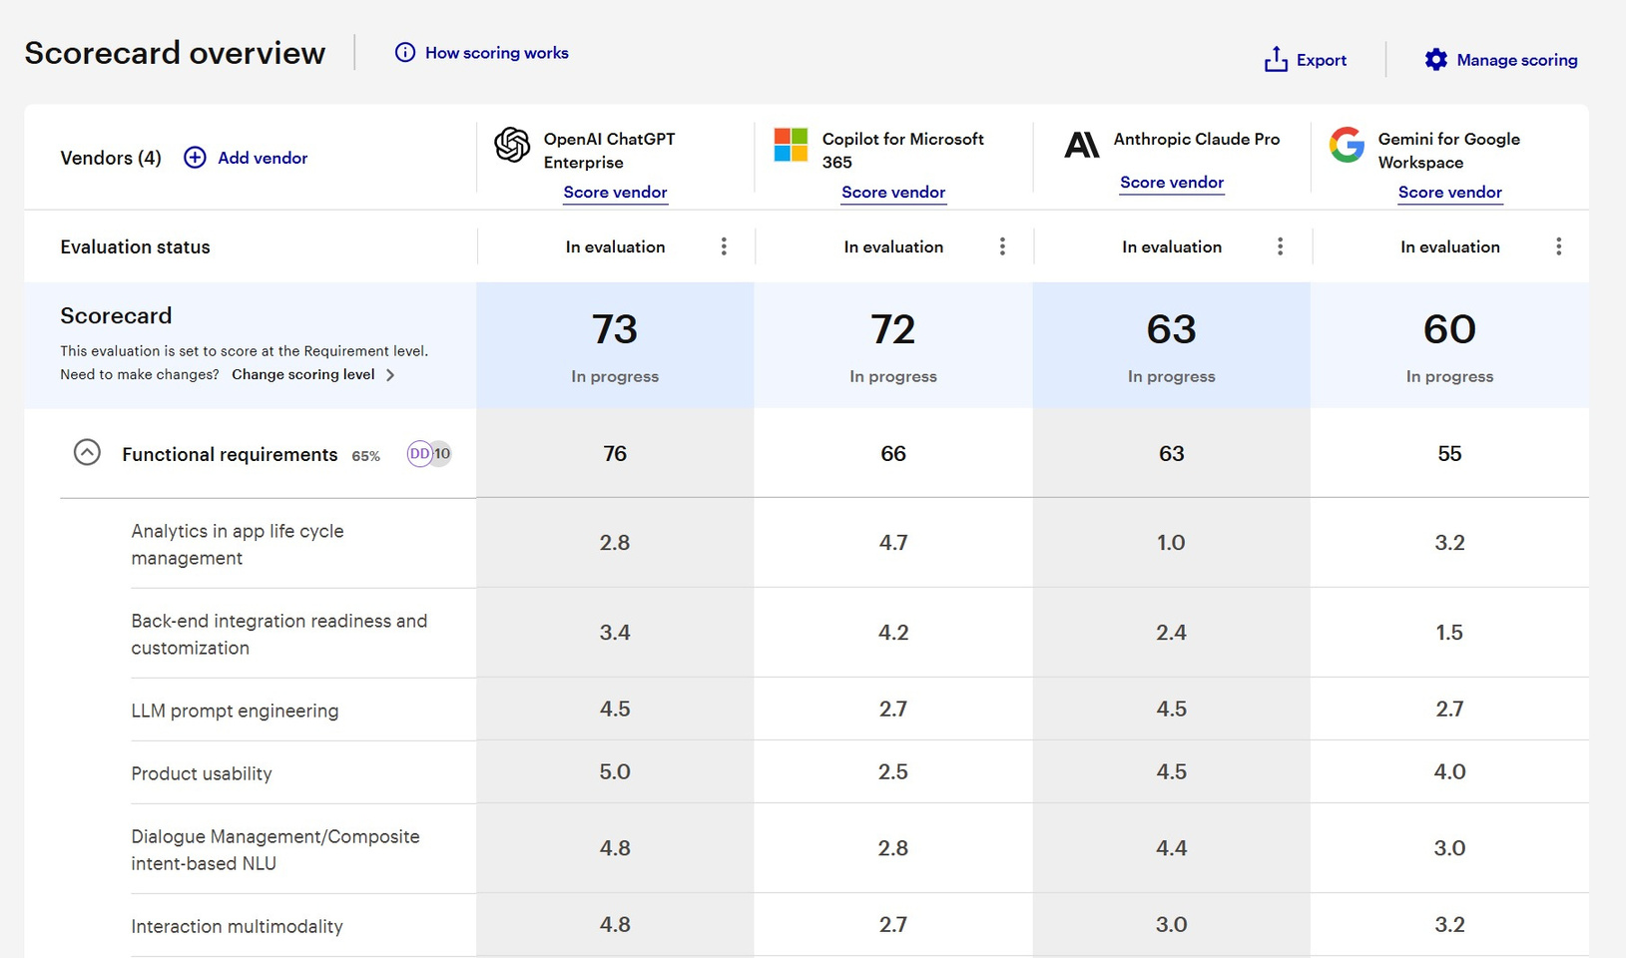


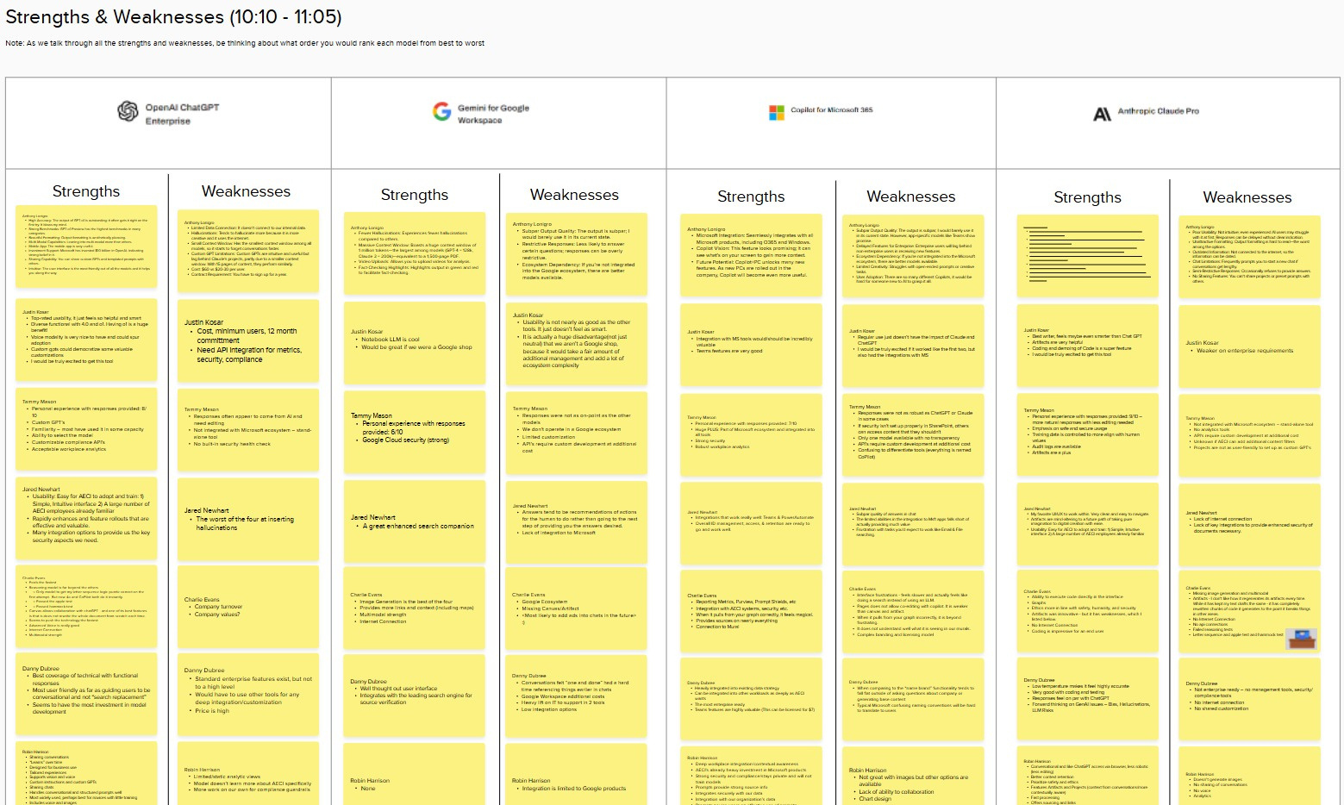
Assessment -
Picking a First GenAI
47 Requirements 6 Categories
Functional Requirements
Technical Requirements Support and Services
Vendor Health
Security & Risk Management
Pricing & Commercial Terms
Associated Electric Cooperative Inc.
Notes:
We partnered with the local agency "Mostly Serious" to streamline our assessment process. They helped us decide to choose one GenAI product in order to train our users on to maintain familiarity and reduce friction of trying to teach core concepts within multiple tools.
We developed a detailed scorecard to prioritize requirements based on our needs and values.
Conducted deep-dive demos of top GenAI tools through their expertise.
This guidance and assessment work facilitated valuable opinions, feedback, and perspectives from all four modes of thought I mentioned earlier. If you are evaluating AI for your company, we highly recommend doing this hard work up front to ensure your have alignment on values before implementation.

Slide 23




a
Training & User Adoption
AI Champions
Role
Responsibilities
Impact
  Test a training program
  Provide actionable feedback
  Advocate for certification
  Successful implementation & adoption
  Influence peers
  Shape the future of Gen AI in our organization
Champions are pioneers, leading the way in adopting and promoting Gen AI.
Associated Electric Cooperative Inc.
Notes:
We reached out to our company during an all-employee meeting
We built a team of 11 individuals from different locations, positions, backgrounds, and experience to help be our first round of AI Trained employees, with the hook that we need their help getting the word out to more people to train up and use AI according to our company procedure.
The training covers core concepts of how it works, how to be safe, ethical, and the most fun part - how to be more effective and efficient than ever before.

Slide 24



Next Steps
Vendor Negotiations
Finalize Guidance
Review Metrics Draft
Complete Certification Program
Rollout Early 2025
Associated Electric Cooperative Inc.
Notes:
We have come to a conclusion and are in process of negotiating terms for a 2025 contract.
Finalize Guidance
Refine the metrics we have drafted. These assessments will help validate adoption, effectiveness, and developing an ROI story we can share with our Executive team and board members to justify continued investment.

Slide 25




112

Slide 26

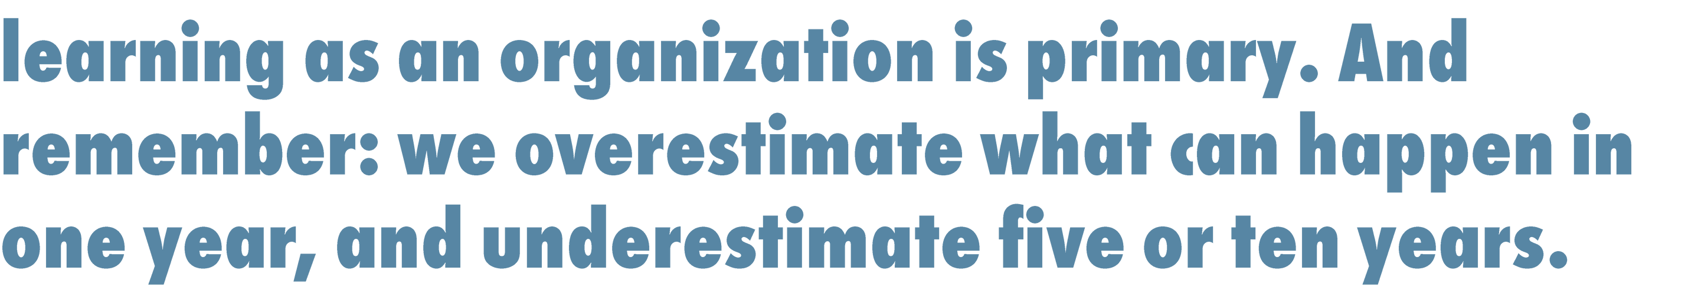
113

Slide 27











114

Slide 28

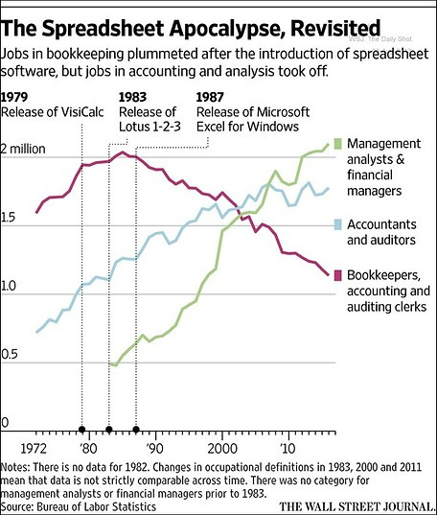







115
Associated Electric Cooperative Inc.

Slide 29
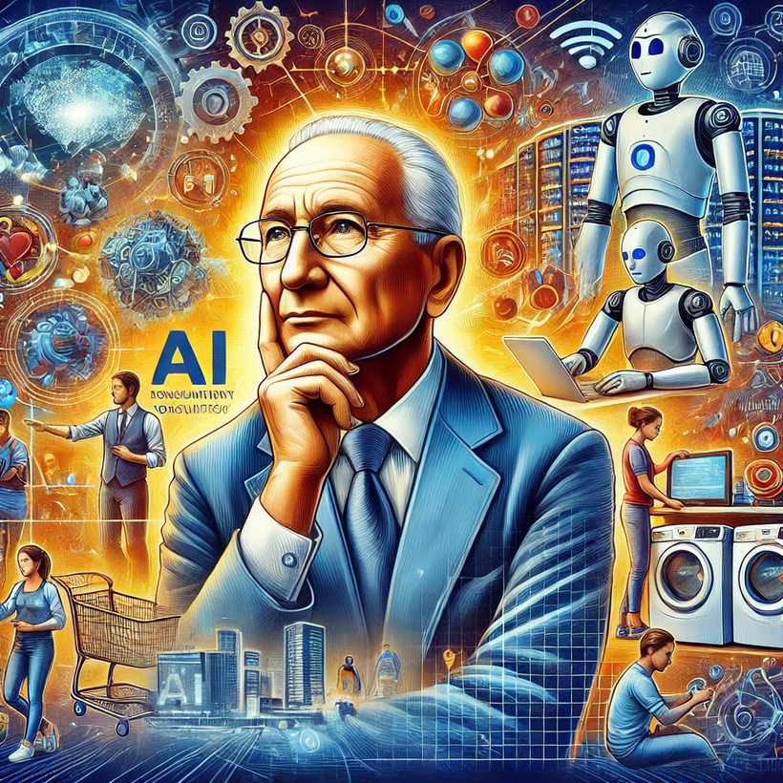
"The greatest danger in times of turbulence is not the turbulence; it is to act with yesterday’s logic." – Peter Drucker
Thank you

